Slide 1
Elections
Congress

Slide 2
Lecture Outline
Balance of Power
The Current Leadership
Polarization
US House/Senate Elections
2022 Pre-Election Analysis
Incumbency Advantages & Disadvantages
2020 Post-Election Results
2018 Post-Election Results
2018 Pre-Election Analysis

Slide 3
Balance of Power
The Current Leadership Ideology and Polarization in Congress

Slide 4
The U.S. Congress The Partisan Split
The Balance of Power (118th Congress)
US House of Representatives (435 members)
222 Republicans
213 Democrats
The composition of the US House changes fairly often between elections, usually because of resignations, deaths (due to old age), crime, and scandals.
Jan. 2014 – Michael Grimm (R-NY) resigned, indicted on tax fraud
Feb. 2015 – Alan Nunnelee (R-MS) died of brain cancer
Mar. 2015 – Aaron Schock (R-IL) resigned, exposed for using taxpayer money for personal vacations (he posted pictures from these trips on social media)
2017 – Resignations or retirements due to allegations of sexual harassment: John Conyers (D-MI), Blake Farenthold (R-TX), Trent Franks (R-AZ), Alcee Hasting (D-FL), Ruben Jesus Kihuen Bernal (D-NV)
2020-21 – Luke Letlow (R-LA) died of COVID-19 (he had no co-morbidities), having just won a seat in Nov. 2020, and Ron Wright (R-TX) died of COVID-19 at age 67 (he had cancer too) in Feb. 2021
2023 – George Santos (NY-3) is under pressure to resign for fabricating his life story and fooling his constituents into voting for him but he has so far refused to resign (as of Feb. 2023)
US Senate (100 members)
51 Democrats (2 are Independents who caucus with Democrats)
49 Republicans
Vice President Kamala Harris will break the tie vote in the Senate (when there is a tie vote)
Texas Delegation to US Congress (38 members)
US House: 25 Republicans 13 Democrats
US Senate: 2 Republican Senators
Notes:
Source: http://en.wikipedia.org/wiki/United_States_House_elections,_2012; http://en.wikipedia.org/wiki/United_States_Senate_elections,_2012; http://www.sourcewatch.org/index.php?title=111th_Congress
Source: cnn.com/elections
Source (sexual harassment in 2017): https://en.wikipedia.org/wiki/2017_United_States_political_sexual_scandals#Allegations_against_members_of_the_United_States_House_of_Representatives
2020 Election Cycle
2018 Election Cycle
2017 Election Cycle
The elections that took place in 2017 may foreshadow a Democratic victory in the 2018 midterm elections. Democrats won the governor’s races in New Jersey (Phil Murphy) and Virgina (Ralph Northam). Also, the special election for Jeff Session’s former US Senate seat in Alabama went to a Democrat, in very red state Alabama (Jeff Sessions vacated the US Senate seat to take the position of Attorney General in the Trump administration). Roy Moore was the Republican in that race, and he was scandalized by his dating teenagers when he was in his 30’s (some 38 years prior). Some of the women he dated then emerged to tell their stories, and two or three alleged that Moore had sexually assaulted them. There were just enough Republicans who decided not to vote for Roy Moore and instead vote 3rd party to result in the Democrat winning the US Senate seat.
2016 Election Cycle
The 2016 congressional elections slightly favored the Democrats, with Democrats picking up 2 seats in the US Senate and 5 seats in the US House. However, the Republicans held on to their majorities in both chambers, which was a victory for Republicans because many pre-election predictions showed that Democrats would win a majority in the US Senate, but that did not happen.
2014 Election Cycle
Republicans netted 13 more seats in the House and 9 seats in the Senate in the 2014 midterm elections. The last time Republicans in the House had a majority this strong was 1928. Republicans campaigned against President Obama’s agenda and it worked. They did not present a Republican agenda, which worried some Republican supporters going into the election, but the anti-Obama sentiment was strong enough to benefit Republicans.
The real fight in 2014 was over which party would control the Senate. Most polls predicted Republicans would pick up 6 seats, which is what they needed to take a majority from the Democrats, but in the end, Senate Republicans did better than predicted, picking up 9 seats, the most of any party since the 1980 elections. 5 Democratic incumbents lost, most from “red” states (Oklahoma, Louisiana, Alaska, North Carolina, Colorado). Democrats often ran against Obama, hoping not to lose votes to the anti-Obama sentiment in the country. For instance, Alison Lundergan Grimes ran ads showing her shooting a hunting rifle and saying “I’m not Barack Obama.” Democrats hoped Grimes could unseat Mitch McConnell (the then Senate Minority Leader), but McConnell won the race on election night by a much wider margin than expected.
2012 Election Cycle
Not only did Barack Obama win reelection, but Democrats picked up 8 seats in the U.S. House and 2 seats in the U.S. Senate. What was probably most notable about congressional elections in 2012 is the mistakes Republican Senate candidates made during the campaign. Todd Akin was the Republican nominee for a Senate seat in Missouri, and when asked about the abortion issue, he said that when a “legitimate rape” occurs, a woman’s body has a way to shut that down (meaning that biologically, the woman’s body will block the pregnancy such that it doesn’t occur). In Indiana, Richard Mourdock, another Republican Senate candidate, said that if a pregnancy occurs as a result of rape then that is “God’s will.” Both comments were foolish, and both candidates lost their respective bids for the U.S. Senate, in states where the Republican candidate should have won. Democrats claimed that Republicans were waging a “war on women,” and these comments fueled that accusation.
Republicans had hoped to win a majority in the U.S. Senate in 2012, but in the end, they lost 2 seats, resulting in a stronger Democratic majority. Republicans held on to the majority in the U.S. House, so there is divided government at the national level.
The Independents: Angus King won a Senate seat in Maine as an Independent, but he caucuses (votes) with the Democrats. King replaced Olympia Snowe (R-ME), who retired because she was tired of the hyper-partisanship in American politics. Bernie Sanders is an Independent from Vermont; he calls himself a socialist, and he too caucuses with the Democrats. Joe Lieberman (D-CT) retired in 2012—he was an independent as well, who voted with the Democrats on most issues but sided with Republicans on matters involving national security.
2010 Election Cycle
The 2010 election cycle was a Republican “wave.” 682 seats at the local, state and national level switched from Democratic control to Republican. That exceeds the 625 seats that switched from Republican to Democratic control in the 1974 election cycle, following the Watergate scandal (which tainted Republicans as corrupt). There was no major scandal in 2010, but what galvanized Republicans was President Obama’s and the Democratic Congress’ health care law (passed in Mar. 2010). The Tea Party rose in opposition to health care, and more generally, to the move toward “bigger government” by Obama and Democrats in Congress. The Republicans won 63 seats in the US House, winning a majority in that chamber. These numbers are historic. A 63-seat swing is the largest since 1948 (which was a presidential election, not a midterm). In the US Senate, the Republicans picked up 6 seats, but Democrats still held on to a majority in that chamber. So, coming out of the 2010 midterm elections, there is divided government in Congress. Republicans made historic gains in state elections in Texas and around the country also. 11 state legislatures switched from Democratic majorities to Republican majorities, and 12 governors switched from Democrats to Republicans. In Texas, Rick Perry was elected governor for a 3rd time, and Republicans won all other executive positions in Texas government. In the Texas House elections, Republicans picked up 25 seats, and Republicans maintained control of the Texas Senate. State elections were important because in 2011 the state legislatures around the country will redraw district boundaries for their respective legislative seats at the state level and for seats in the US House, and many of these states are now controlled by Republicans and will draw district boundaries to help the chances of Republicans in elections that will occur over the next decade, until a new census is taken in 2020 and the district lines are redrawn again.
The coming Republican wave was evident early in 2010. In January 2010, Massachusetts held a special election to fill the US Senate seat Ted Kennedy had held for 46 years (Kennedy died of brain cancer in 2009). Surprisingly, a Republican (Scott Brown) won the special election. Brown made opposition to Obama’s heath care plan the focus of his campaign, and the Massachusetts voters responded favorably to Brown’s message, despite that Ted Kennedy had been a champion of health care reform for decades (and the same Massachusetts electorate elected Kennedy seven times). Some political analysts predicted that the special election in Massachusetts portended a nationwide trend, a backlash against the Democratic leadership in Congress and against President Obama. They also point to the Governor’s races in NJ and Virginia (Nov. 2009), both of which were won by Republicans. These political analysts turned out to be right. 2010 was a big year for Republicans.
A couple of sex scandals affected the composition of members in the US House in 2011. Rep. Lee (R-NY) resigned after being caught trying to date a woman he met on Craig’s List. Lee lied about his age, marital status, and occupation, and a woman who was considering a date with Lee did some research to uncover the lies. She then reported Rep. Lee to a tabloid magazine, which broke the story. Lee immediately resigned his seat in the US House once the story broke, and the seat was filled in a special election by Kathy Hochul (D-NY) in May 2011. In a second sex scandal, Rep. Weiner (D-NY) resigned after having sexually explicit text-message exchanges with several women. A conservative blogger was informed of Weiner’s behavior and exposed to the country a picture Weiner had posted of himself in his underwear. For two weeks, Weiner denied that he had posted the picture after the story broke, but when the Democratic leaders in Congress failed to come to his defense, Weiner admitted to posting the picture and resigned his seat in the US House. Weiner’s seat was filled in a special election by Bob Turner (R-NY) in Sept. 2011.
Kathy Hochul’s victory in New York district #26 in May 2011 may signal a Democratic comeback in 2012. She ran on keeping Medicare intact as it currently exists, in contrast to Paul Ryan’s (R-WI) plan to restructure Medicare into a voucher program. Hochul replaced Christopher Lee (R-NY) (mentioned above). Following Hochul’s victory, Democrats across the country are planning to run against Paul Ryan’s Medicare reform proposal. We’ll see if that works. There is counter-evidence though. Bob Turner’s (R-NY) victory in New York District #9 in Sept. 2011 may signal another Republican victory in 2012. Turner replaced Anthony Weiner (D-NY) (also mentioned above). Turner won in a district that had been held by Democrats since 1923, and he ran against Obama’s policies toward Israel and gay marriage. The district had a large Jewish population, and former NY Mayor Koch (a Jew) campaigned hard against Obama. The president had made a speech earlier in 2011 in which he said the borders between an Israeli state and a Palestinian state should be defined by the armistice agreement in 1949 following the 1948 war (which Israel won). Natanyahu, the PM of Israel, rejects the 1948 borders, believing them to tempt Israel’s enemies to attack because Israel is only 9 miles wide with those borders, thus appearing to be more vulnerable. In America, a high-ranking politician cannot go against Israeli interests; the Israeli lobby in America is just too powerful. Obama appeared to go against Israel’s interests when he endorsed the 1948 borders, and he paid the price for that in NY-9.
The Independent Democrats: Senator Lieberman (CT) lost in the Democratic primary in Aug 2006 but then ran as an independent in the general election and defeated the Democratic and Republican candidates in Nov 2006. Senator Sanders (VT) retired from the House and ran and won a Senate seat as a socialist candidate. Both Lieberman and Sanders vote with Democrats, though Lieberman supported Bush on the issue of the Iraq War (that’s why he was defeated in the Democratic primaries in Aug 2006). Lieberman is too conservative for Connecticut and has decided not to run for reelection in 2012.
2008 Election Cycle
In the 2008 elections, Democrats increased their margins over Republicans. The Democrats picked up an additional 21 seats in the US House and 8 seats in the US Senate. It was another Democratic “wave” election. In the Senate, just after the election, the Democrats had a near filibuster-proof Senate, meaning that the Republicans had little chance of blocking any legislation the Democrats desire. (A filibuster occurs when at least 41 Senators combine forces to block legislation. The filibuster can be broken by a vote of 60 Senators, then the full Senate can vote on the measure.) In April 2009, Senator Arlen Specter (Pennsylvania) switched parties from the Republican Party to the Democratic Party. Specter said the Republican Party had moved too far right and that he finds himself more aligned with the Democratic philosophy; he also believed he could not win in the Republican primaries in the next election cycle. Specter switch gave the Democrats 59 seats in the US Senate, and once the Minnesota Supreme Court found Al Franken to be the winner of the seat in Minnesota (it took 8 months to decide the Senate race in Minnesota), the Democrats had 60 seats in the US Senate (in 2009). Interestingly, Arlen Specter lost his bid to win the Democratic primary in Mar. 2010, in part because the voting public in PA. objected to Specter’s switch to the Democratic Party. Specter switched parties simply for political reasons—he believed he could not win the Republican nomination in 2010, so he became a Democrat, believing that he had a better chance of winning the Democratic nomination, but he turned out to be wrong.
The balance of power between 2008 and 2010: US House: 255 Democrats; 177 Republicans (1 Democrat and 2 Republicans had resigned between elections…The US House was 3 members short in 2010 due to these resignations); US Senate: 59 Democrats; 41 Republicans (2 Democratic Senators call themselves Independent Democrats)
2006 Election Cycle
The 2006 midterm election was a “Democratic” wave, meaning the Democrats did exceptionally well. Democrats won majorities in both the US House and US Senate in the 2006 midterm elections (Nov 2006), so power in both chambers switched from Republican to Democratic. Republicans had previously controlled both chambers from 1994 to 2006. In Texas, Democrats did better than usual but not well enough to win majorities in the Texas Legislature. Democrats picked up 5 seats in the Texas House, but Republicans picked up 1 seat in the Texas Senate. The balance of power after the 2006 elections -- US House: 233 Democrats; 202 Republicans. Between 2006 and 2008, Democrats picked up 3 seats in special elections (the incumbent resigned). These three were strong Republican seats, but Democrats won them.
The previous balances of power were as follows:
116th Congress (Jan. 2019 to Jan. 2021)
US House of Representatives (435 members)
235 Democrats
199 Republicans
The composition of the US House changes fairly often between elections, usually because of resignations, deaths (due to old age), crime, and scandals.
Jan. 2014 – Michael Grimm (R-NY) resigned, indicted on tax fraud
Feb. 2015 – Alan Nunnelee (R-MS) died of brain cancer
Mar. 2015 – Aaron Schock (R-IL) resigned, exposed for using taxpayer money for personal vacations (he posted pictures from these trips on social media)
2017 – Resignations or retirements due to allegations of sexual harassment: John Conyers (D-MI), Blake Farenthold (R-TX), Trent Franks (R-AZ), Alcee Hasting (D-FL), Ruben Jesus Kihuen Bernal (D-NV)
US Senate (100 members)
53 Republicans (1 is an Independent who caucuses with Republicans)
Aug. 2018 – Sen. John McCain (R-AZ) died. The Governor of Arizona appointed John Kyle (R-AZ) as McCain’s replacement, then in Jan. 2019, replaced Kyle with Martha McSally (R-AZ)
47 Democrats (2 are Independents who caucus with Democrats)
Texas Delegation to US Congress (38 members)
US House: 23 Republicans 13 Democrats
US Senate: 2 Republican Senators
115th Congress (Jan. 2017 to Jan. 2019)
US House of Representatives (435 members)
238 Republicans
193 Democrats
US Senate (100 members)
51 Republicans (1 is an Independent who caucuses with Republicans)
Aug. 2018 – Sen. John McCain (R-AZ) died. The Governor of Arizona appointed John Kyle (R-AZ) as McCain’s replacement
49 Democrats (2 are Independents who caucus with Democrats)
114th Congress (Jan. 2015 to Jan. 2017)
US House of Representatives (435 members)
245 Republicans
188 Democrats
The composition of the US House changes fairly often between elections, usually because of resignations or deaths (usually due to old age). Aaron Schock (R-IL) resigned after he was exposed for using taxpayer money for personal vacations all over the world (he posted pictures from these trips on social media). Michael Grimm (R-NY) resigned after being indicted on tax fraud, underreporting income. Alan Nunnelee (R-MS) died of brain cancer in Feb. 2015
US Senate (100 members)
54 Republicans
46 Democrats (2 are Independents who caucus with Democrats)
113th Congress (Jan. 2013 – Jan. 2015)
US House of Representatives (435 members)
233 Republicans – 201 Democrats – The composition of the US House changes fairly often between elections, usually because of resignations or deaths (due to old age). In 2011, two members were forced to resign because of sex scandals.
US Senate (100 members)
55 Democrats (2 are independent Democrats) – 45 Republicans
Sen. Frank Lautenberg (D-NJ) died in June (2013) and was temporarily replaced by a Republican, Jeff Chiesa (R-NJ)…a special election was held Oct 2013 to fill the seat, and Cory Booker (D-NJ), mayor of Newark, won the election. The U.S. Senate is up for grabs in the 2014 Midterm Elections
112th Congress (Jan. 2011 – Jan. 2013)
US House of Representatives (435 members)
240 Republicans – 191 Democrats – 4 vacancies at the end of the term
US Senate (100 members)
53 Democrats (2 are independent Democrats) -- 47 Republicans
Texas Delegation to US Congress (34 members)
US House: 23 Republicans 9 Democrats
US Senate: 2 Republican Senators
111th Congress (Jan 2009 – Jan 2011)
US House of Representatives (435 members)
257 Democrats -- 178 Republicans
US Senate (100 members)
59 Democrats (2 are independent Democrats) -- 41 Republicans
Texas Delegation to US Congress (34 members)
US House: 20 Republicans 12 Democrats
US Senate: 2 Republican Senators
110th Congress (Jan 2007 – Jan 2009)
US House
236 Democrats -- 199 Republicans
US Senate
51 Democrats (2 Independent Democrats) -- 49 Republicans
109th Congress (Jan 2005 – Jan 2007):
US House
232 Republicans -- 196 Democrats
US Senate
55 Republicans -- 44 Democrats -- 1 Independent
Texas Delegation to US Congress (Jan 2019 – Jan 2021)
US House: 23 Republicans 13 Democrats
US Senate: 2 Republican Senators
Texas Delegation to US Congress (Jan 2017 – Jan 2019)
US House: 25 Republicans 11 Democrats
US Senate: 2 Republican Senators
Texas Delegation to US Congress (Jan 2015 – Jan 2017)
US House: 24 Republicans 12 Democrats
US Senate: 2 Republican Senators
Texas Delegation to US Congress (Jan 2009 – Jan 2011)
US House: 20 Republicans 12 Democrats
US Senate: 2 Republican Senators
Texas Delegation to US Congress (Jan 2007 – Jan 2009)
US House: 19 Republicans 13 Democrats
US Senate: 2 Republican Senators
Texas Delegation to US Congress (Jan 2005 – Jan 2007)
US House: 21 Republicans 11 Democrats
US Senate: 2 Republican Senators

Slide 5

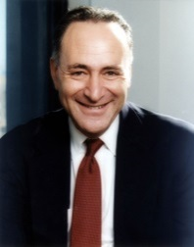
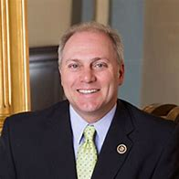
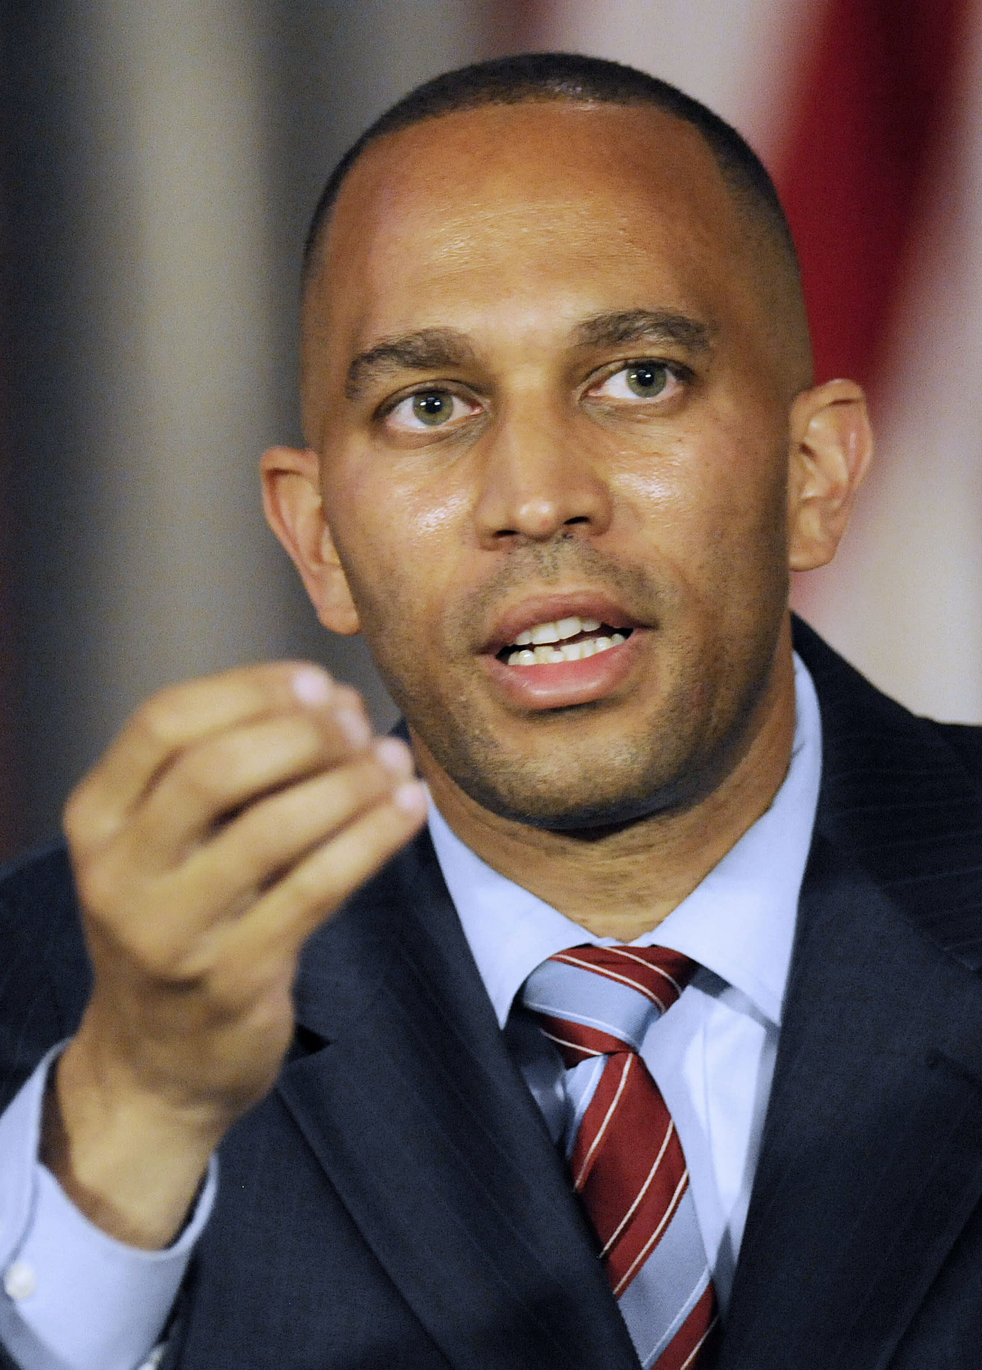
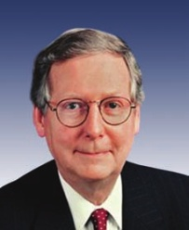
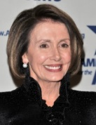
The U.S. Congress Who holds the power??
Kevin McCarthy became Speaker after 15 votes (usually the Speaker is elected in one vote) in 2023. The fiscally conservative wing of House Republicans demanded McCarthy make concessions, such as on limiting spending and committee assignments
Congressional power brokers
US House: Speaker of the House
Kevin McCarthy (R-CA)
US Senate: Majority Leader
Charles Schumer (D-NY)
Other powerful positions
US House
Majority Leader: Steve Scalise (R-LA) Minority Leader: Hakim Jefferies (D-NY)
US Senate
Minority Leader: Mitch McConnell (R-KY)
Chuck Schumer became Majority Leader in 2021, after Democrats picked up 3 seats in the U.S. Senate in 2020
Historical Firsts
Hakim Jefferies became Minority Leader of the U.S. House in 2023, the first black person to hold the position, after Nancy Pelosi decided no longer to lead the Democratic Party in the House
Nancy Pelosi was Speaker from 2007 – 2011 and again from 2019 – 2023, and she was the first female Speaker in U.S. History.
Notes:
The Speaker of the House is a Republican because Republicans are the majority party in the U.S. House. The Speaker is selected in a vote of the entire US House, so if Republicans control a majority of seats, then a Republican will win the Speakership. The same procedure is in place in selecting the Majority Leader in the Senate.
---------------------------------
In October 2015, John Boehner announced that he would resign in November (2015). Kevin McCarthy seemed to be the next in line for the Speakership, but in an effort to show that he had advanced the Republican Party’s agenda, he bragged that he had helped establish the Benghazi committee, and, in its investigation into Hillary Clinton’s actions as Sec. of State on the night of the terrorist attack on our diplomatic mission in Benghazi, Libya, that the committee’s investigation had damaged Hillary Clinton’s poll numbers in the 2016 presidential race, implying that the committee’s purpose was purely political. Other Republicans in the House were outraged at McCarthy’s comments, and he eventually withdrew his name from consideration for Speaker. McCarthy, however, remained as House Majority Leader.
In 2014, Mitch McConnell (R-KY) was in what was perceived to be a tight race with Alison Lundergan Grimes (Democrat), but McConnell won easily on Election Day (2014), winning 56% of the vote to 40% for Grimes.
Harry Reid did not seek reelection in 2016, meaning that the Democrats had to find a new leader in the U.S. Senate. Judicial Watch, a corruption watchdog group, claims that corruption scandals finally drove Reid to resign from Congress. See http://www.judicialwatch.org/blog/2015/03/corruption-scandals-led-to-harry-reids-abrupt-retirement/
Examples of the influence of Anti-Incumbent Sentiment
There was high-levels of anti-incumbent sentiment in 2018, and probably the best illustration of that was the defeat of Joseph Crowley (D-NY), a 10-term congressman. An unknown Bernie Sanders-inspired candidate named Alexandria Ocasio-Cortez defeated Crowley in the New York primary for District 14, wining 57% of the vote. The district is heavily Democratic, so Ocasio-Cortez went on to easily defeat her Republican opponent in the general election in Nov. 2018. What’s more interesting is that Crowley was considered by some to be a candidate for Speaker of the House, if the Democrats were to win a majority in the 2018 midterm elections. He was in the leadership of the Democratic Party, serving as Chair of the Democratic Caucus in Congress.
There was also a lot of anti-incumbent sentiment in the electorate in 2014. Eric Cantor (R-SC), the House Majority leader at the time, was defeated by a university professor in the Republican primary in SC. Anti-incumbent sentiment is akin to being anti-establishment, and members of Congress in leadership positions of their respective political parties and voters often associated the leadership with the “establishment.” Being in the leadership of the Republican Party, Cantor was associated with more government spending and other unpopular positions that many Republican voters oppose, and Cantor didn’t spend a lot of time in his district maintaining close ties to his constituents, so he was caught off guard when an unknown university professor defeated him in the primaries. After his defeat in the primaries, Cantor then stepped down as Majority Leader. He served in the U.S. House until January 2015—that’s when the winners in the Nov. 4th (2014) elections took their seats in Congress. Kevin McCarthy was then selected by the Republican Conference in the House to be the Majority Leader.

Slide 6
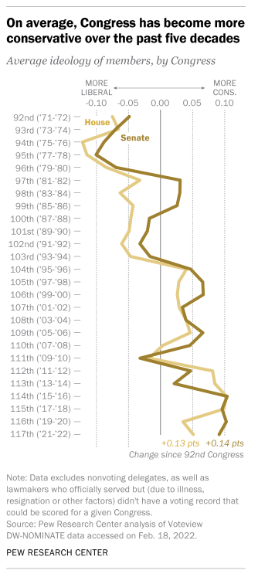
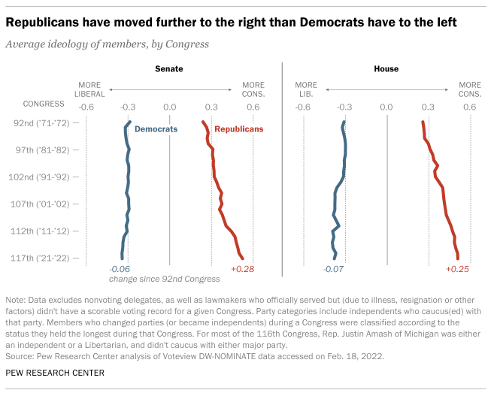
The U.S. Congress Trends in Ideology
Overall, Congress has become more conservative in the last 50 years, driven by Republicans who have moved to the right more so than Democrats to the left
Notes:
https://www.pewresearch.org/fact-tank/2022/03/10/the-polarization-in-todays-congress-has-roots-that-go-back-decades/

Slide 7
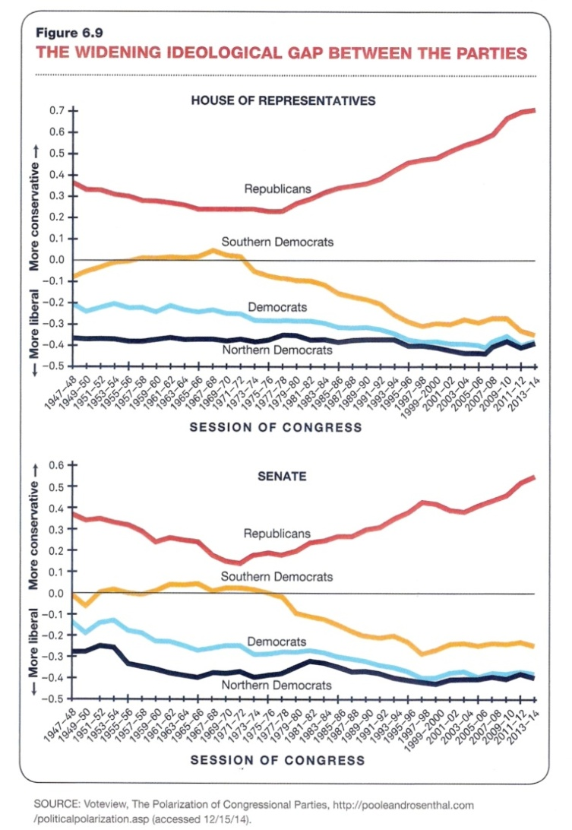
The U.S. Congress Polarization
The gap in ideological voting has increased since the 1980s, when Republicans began to advocate for smaller government—over time, Republicans have voted more conservative, Democrats more liberal
There are internal divisions as well, in both parties, with “establishment” Republicans opposing “Trump” Republicans, and “establishment” Democrats opposing “Bernie Sanders/AOC” Democrats
Decades ago, Democrats had internal divisions, with “conservative” (southern) Democrats opposing “liberal” (northern) Democrats
Notes:
Source (for graphic): American Government, Power and Purpose 13th ed.
AOC – Alexandria Ocasio Cortez (D-NY), who is a young and progressive up-and-comer in the Democratic Party
https://www.pewresearch.org/fact-tank/2022/03/10/the-polarization-in-todays-congress-has-roots-that-go-back-decades/

Slide 8
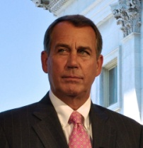
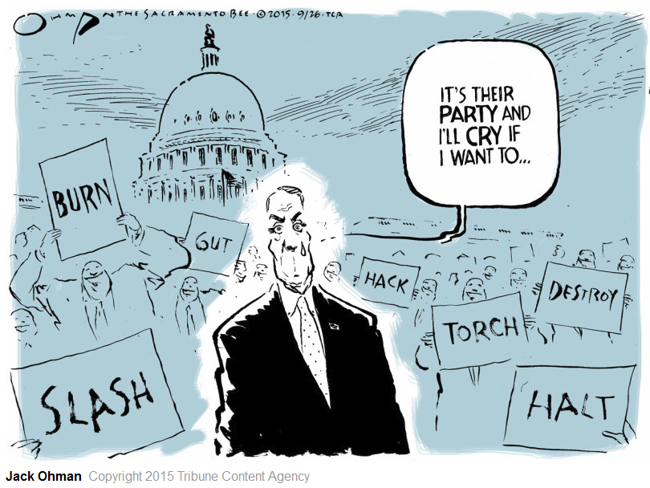
The U.S. Congress Divisions Among Republicans
John Boehner (R-OH) was Speaker of the House from 2011 to 2015. His own Republican Party forced him to resign
The then Tea Party wing of the Republican in the U.S. House forced Boehner to resign as Speaker
Boehner refused to secure cuts in spending or to use a government shutdown as leverage in negotiations in cuts in spending, and the Tea Party wing insisted that its leaders push for smaller government
What about the Democrats? Similar divisions could emerge between the Establishment Democrats and the Bernie Sanders/AOC-Socialist wing of the party
Notes:
A “Tea Party” wave won a Republican majority in the U.S. House in 2010, and John Boehner was elected Speaker, even though he was an “establishment” Republican. The “Tea Party” Republicans wanted smaller government, via spending cuts, but Boehner was not able to secure cuts in spending because he refused to face-off against President Obama, fearing that Republicans would be blamed for shutting down the government in a showdown over spending cuts. Like Newt Gingrich in 1998, Boehner’s own Republican Party ousted him as Speaker of the House in 2015 for not fulfilling the “Tea Party” agenda of smaller government (spending cuts). Paul Ryan (R-WI) became Speaker after John Boehner in 2015, and he remained Speaker until 2019, when he resigned from Congress. Ryan also had problems satisfying the smaller government agenda, and this may have contributed to his decision to resign from Congress.
In 2023, Kevin McCarthy (R-CA) was elected Speaker after 15 ballots. Because the margins between Republicans (222) and Democrats (213) were so close, a few members of the Freedom Caucus wing of the Republican party, who want less government spending and to pay down the national debt (which is approximately $33 Trillion and counting), could block McCarthy’s election as Speaker, so McCarthy had to make concessions, such as putting Freedom Caucus members on key committees, such as the Rules Committee (which determines which bills get voted on and how long members have to study the bill before the vote—Freedom Caucus members wanted more than 24 hours to read a bill before voting). They also demanded that only one member of the U.S. House could call for a recall vote of McCarthy. In early October 2023, after McCarthy had agreed to a 45-day spending measure to keep the government funded (to avoid a government shutdown), Matt Gaetz (R-FL) demanded a recall of McCarthy, and McCarthy was ousted as Speaker, 216-210. All 208 Democrats voted with 8 Republicans to oust McCarthy. The Democrats decided not to save McCarthy because they didn’t trust him + they enjoyed seeing Republicans destroy each other, so the Democrats just decided to get out of the way and allow the in-fighting to occur on the Republican side. McCarthy suffered the same fate for the same reason as previous Republican Speakers (Gingrich in 1998, Boehner in 2015, Ryan in 2019). He was not able to cut spending, nor was he able to reduce the debt, and consequently, members of his own party ousted him.
The Cartoon explained: The capitol building is symbolic of Congress, so the guy crying must be John Boehner, who announced his resignation from Congress in October 2015. He is crying because Boehner was often mocked for openly crying in public numerous times during his tenure as Speaker. “It’s their party” implies that the people in the background holding very hostile signs are members of Boehner’s Republican Party, who wanted him gone from not accomplishing enough as Speaker of the House.
What happened to the Tea Party?
The Tea Party backed Republican candidates in the 2010, 2012, and 2014 elections, and it showed its muscle most prominently in the 2012 U.S. Senate race in Texas for the Republican nomination, during which Tea Party-backed Ted Cruz easily defeated establishment Republican David Dewhurst for the Republican nomination for the U.S. Senate seat formerly occupied by Kay Bailey Hutchinson. Cruz went on to win the US Senate seat from Texas.
In 2016, Donald Trump was a elected president, and the Tea Party all but disappeared, which is an indication that Trump satisfied this movement (movements disappear when their agenda is adopted, and Trump represented enough of the Tea Party agenda to satisfy the movement goals). Despite Biden being elected president in 2020, Trump is still a factor in Republican Party politics. If Trump runs for president again in 2024 and loses, then it is possible the Tea Party will reemerge as a force in Republican Party politics, but for now, Trump’s influence has coopted the Tea Party, and now there is a Trump wing of the Republican Party.

Slide 9
Midterm Elections
The Historical Trend

Slide 10
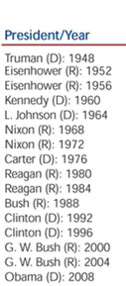
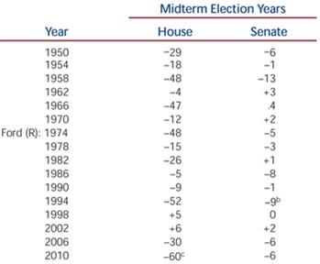
U.S. House/Senate Elections Trends in Midterm Elections
Midterm Election Trends
The president’s party typically loses seats in a midterm election (the negative numbers indicate the number of seats the president’s party lost)
The trend is particularly strong in the US House
As for incumbents, they are most vulnerable in midterm elections, when they are affiliated with the same political party as the president
Midterm Election Year | U.S. House | U.S. Senate
Obama (D): 2014 | -13 (seats D’s lost) | -9 (seats D’s lost)
Trump (R ): 2018 | -40 (seats R’s lost) | +2 (seats R’s won)
Biden (D): 2022 | -9 (seats D’s lost) | +1 (seats D’s won)
Notes:
Midterm elections occur at the midterm of a presidency. They occur in years where the president is not up for election. In each midterm election, the entire membership of the US House is up for election as well as 1/3rd of the members of the US Senate. Some examples of midterm election years: 2010, 2014, 2018, 2022, 2026, etc.
In midterm elections (see non-presidential election years in the table), the president’s party usually loses seats in the US House. The trend in midterm elections is strongest in US House elections. The president’s political party usually loses seats in the US House midterm elections. But this did not occur in 1998 or in 2002. It also didn’t occur in 1934 (not shown in the table). Each of these were extraordinary circumstances. In 1934, the country was in the depths of the Great Depression, so more Democrats were elected that year because the country wanted to give the Democrats the chance to pull the country out of the depression. In 1998, Clinton was facing impeachment for lying about his affair with Monica Lewinsky, and the public rallied behind Clinton because they felt he was being attacked unjustly, for personal reason and not for professional reasons. That’s why more Democrats were elected in 1998. In 2002, 9/11 had occurred the year before and the public was rallying behind the president to protect the country. That’s why more Republicans were elected in 2002.
Under normal circumstances, the opposition to the president strengthens after the honeymoon period is over (the honeymoon is the first 6 months after a presidential election) , so once the president reaches the midterm of his presidency, the opposition is confident enough to attack the president’s policies, which may not be working after being in office for a while. And since the president is not running for reelection at midterm, his influence is not as strong. So, this combination usually means the president’s party loses seats in midterm elections.
“Wave” elections occurred in 1994, 2006, 2010, 2014, and 2018. That is, the trend in these elections years were even stronger than usual. In 1994, the country had tired of 40 years of Democratic rule of the US House and thus threw out the Democrats; in 2006, the country was frustrated by the never-ending violence in Iraq and tired of corruption associated with Republican leadership; consequently, the public punished the Republicans for it; in 2010, the Republicans won the most seats (63 seats) than in any previous midterm election since 1950. Many of these Republicans won by running against Obama’s health care law, and more generally, the president’s advocacy of “bigger government;” in 2014, the Republicans won 9 seats in the US Senate, the best win for Republicans since 1980 and the best win for any party in a midterm election since 1958, when Democrats picked up 13 seats in the US Senate (Eisenhower was president). In 2018, the election was essentially a referendum on Donald Trump’s presidency, particularly regarding his unconventional behavior, and Democrats gained 40 seats, claiming a majority in the U.S. House (Republicans held on to the majority in the U.S. Senate).

Slide 11
Balance of Power
Pre-Election Analysis: 2022 Congressional Elections

Slide 12
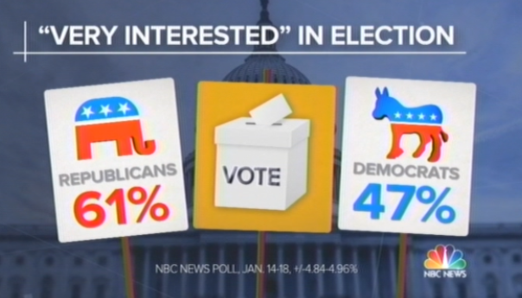
2022 Congressional Elections Pre-Election Analysis (Jan. 2022): The Influence of “Enthusiasm to Vote”
The “enthusiasm gap” favored Republicans by 14% in January 2022.
A double-digit gap in “enthusiasm to vote” or “interest in the election” is a good predictor of a “wave” election
The President’s Party Often Loses Seats in Congress in Midterm Elections
President – Year | U.S. House Seats Won | U.S. Senate Seats Won
Clinton (D) – 1994 | R +52 | R +10
Bush (R) – 2006 | D +30 | D +6
Obama (D) – 2010 | R +63 | R +6
Obama (D) – 2014 | R +13 | R +9
Trump (R ) -- 2018 | D +40 | R +2
Note: There was a change in the majority in each of these elections except in the U.S. Senate in 2010 and 2018
1994, 2010 and 2014 were “wave” midterm elections for Republicans in Congress, while there was an incumbent Democratic President.
2006 and 2018 were “wave” midterm elections for Democrats in Congress, while there was an incumbent Republican President.
Notes:
https://www.cnn.com/2022/02/19/politics/enthusiasm-republican-midterms-high/index.html
https://fivethirtyeight.com/features/why-the-presidents-party-almost-always-has-a-bad-midterm/

Slide 13
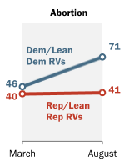
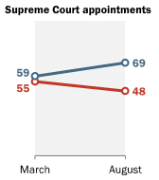
2022 Congressional Elections Pre-Election Analysis (Post-Dobbs): A Possible Reversal to Historical Trends
There were extraordinary circumstances in 1998 and 2002 which resulted in a reversal of the historical trend in midterm elections, and in 2022, it is possible that the U.S. Supreme Court decision to overturn Roe v. Wade, abolishing a fundamental right to abortion and giving states full authority to regulate abortion, might turn out to be an extraordinary circumstance in 2022
The Trend in Midterm Elections is Reversed under Extraordinary Circumstances
President – Year | U.S. House Seats Won | U.S. Senate Seats Won
Clinton (D) – 1998 | D +5 | D +0
Bush (R) – 2002 | R +6 | R +2
Biden (D) – 2022 | D -9 | D +1
Note: There was no change in the majority in each of the elections in 1998 and 2022
In 1998, the Republican effort to impeach then President Bill Clinton backfired, politically, and the voters elected more Democrats
In 2002, the 9/11 terrorist attacks were still fresh in the psyche of the American public, and the voters elected more Republicans
Notes:
Dobbs = Dobbs v. Jackson Women’s Health Organization (June 24 2022) – The U.S. Supreme Court Decision in which the Court overturned Roe v. Wade, abolishing the right to abortion and giving states the authority to regulate abortion policy
Source: “Abortion Rises in Importance as a Voting Issue, Driven by Democrats,” Aug. 23, 2022. https://www.pewresearch.org/politics/2022/08/23/abortion-rises-in-importance-as-a-voting-issue-driven-by-democrats/
Opinion: Will America's midterms in 2022 replicate 1866? | CNN https://www.cnn.com/2022/10/11/opinions/2022-midterm-elections-1866-sinha/index.html – An interesting article comparing post-Civil War 1866 to the 2022 midterm elections.

Slide 14
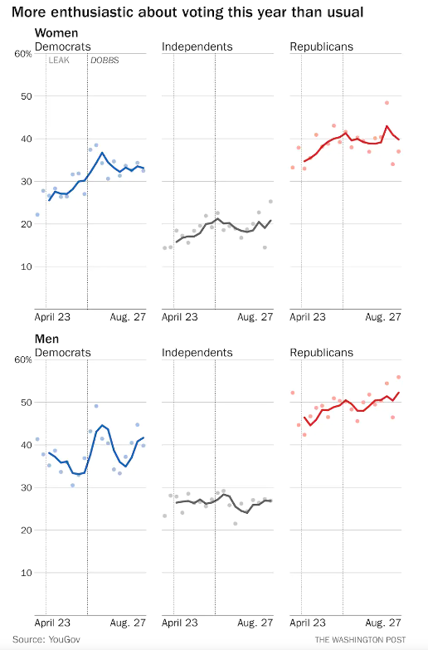
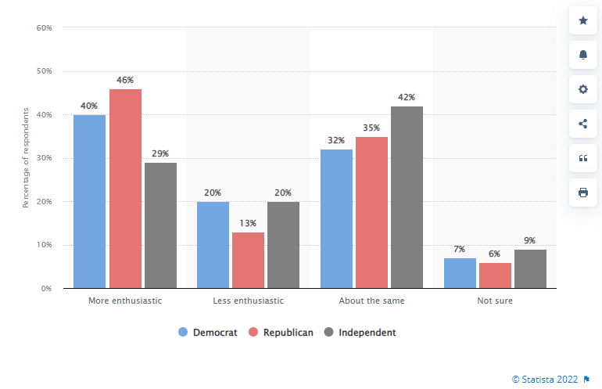
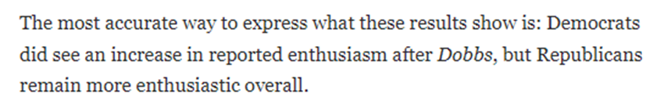
2022 Congressional Elections Pre-Election Analysis (Post-Dobbs): “Enthusiasm to Vote”
Even after the U.S. Supreme Court decision to overturn Roe v. Wade, Republicans have maintained an edge in “enthusiasm,” but the gap is less than 10% (over Democrats), which would predict a Republican win in 2022 (for U.S. House) but not as big a win as might be otherwise expected by historical standards in midterm elections
Republican women are ~7% more enthusiastic to vote than Democratic women
Republicans are 6% more enthusiastic to vote than Democrats in this Statistica poll
Republican men are ~10% more enthusiastic to vote than Democratic men
Notes:
Dobbs = Dobbs v. Jackson Women’s Health Organization (June 24 2022) – The U.S. Supreme Court Decision in which the Court overturned Roe v. Wade, abolishing the right to abortion and giving states the authority to regulate abortion policy
Source: https://www.washingtonpost.com/politics/2022/09/07/midterm-elections-poll-republicans/ -- Sept. 7, 2022
Source: https://www.statista.com/statistics/1315566/voting-enthusiasm-us-party-id/ -- Aug. 19, 2022
NBC News poll: 57% of voters say investigations into Trump should continue https://www.nbcnews.com/meet-the-press/first-read/nbc-news-poll-57-voters-say-investigations-trump-continue-rcna43989 (Aug. 21, 2022) – This NBC News poll finds that Republicans are more enthusiastic to vote, but barely, 68% to 66% (a 2% margin over Democratic enthusiasm). Earlier in the year, the NBC News poll found that Republicans had a 17% margin in enthusiasm in March 2022, then down to an 8% margin in May 2022 (after the leak of the U.S. Supreme Court decision).
https://morningconsult.com/2022/08/17/republicans-enthusiasm-biden-popularity-2022-midterms/ (Aug. 17, 2022) -- This Morning Consult poll found that Republicans have an edge in enthusiasm to vote, but again, only barely, 65% to 62%, a 3% margin over Democratic enthusiasm to vote

Slide 15
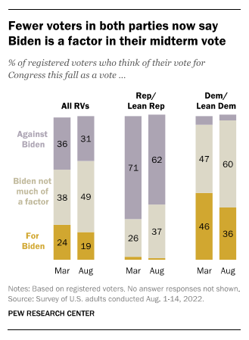
2022 Congressional Elections Pre-Election Analysis (Post-Dobbs): Motivation to Vote For/Against Biden
Even though the president is not up for election in 2022, voting against Biden’s party could be a strong motivator for Republicans (and voting for Biden’s party could be a motivator for Democrats)
Republicans are far more motivated to vote against President Biden in the Midterm Elections than Democrats are motivated to vote for the president
62% of Republicans say their vote will be against the president, while 36% of Democrats say their vote will be for Biden, a margin of 26%
Notes:
Source: “Abortion Rises in Importance as a Voting Issue, Driven by Democrats,” Aug. 23, 2022. https://www.pewresearch.org/politics/2022/08/23/abortion-rises-in-importance-as-a-voting-issue-driven-by-democrats/

Slide 16
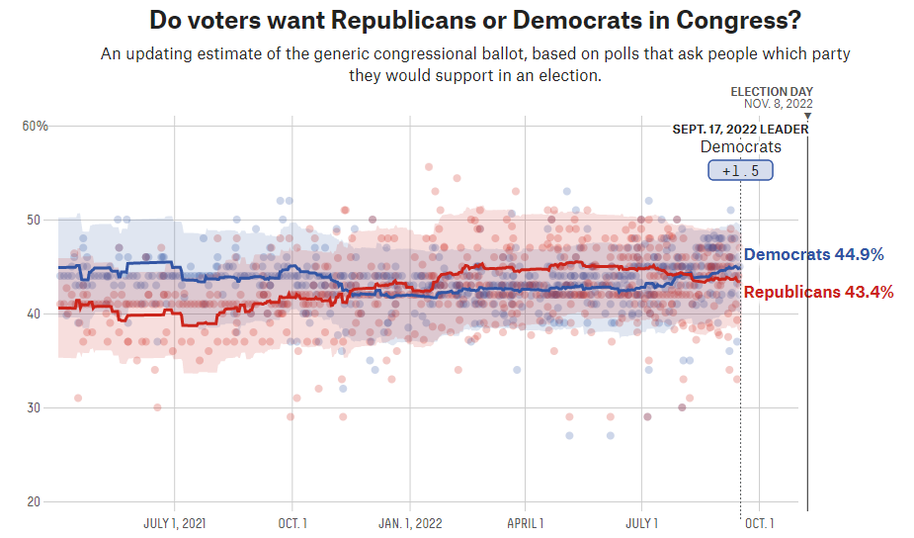
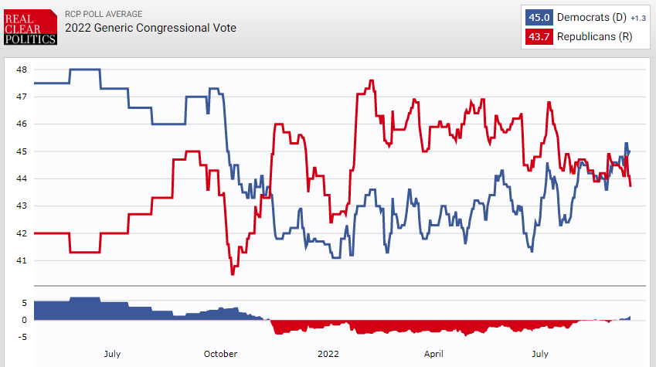
2022 Congressional Elections Pre-Election Analysis (Mid-September 2022): The Generic Poll
We don’t elect members of Congress by a nationwide generic poll; nevertheless, the generic poll is an indication of which party may win more seats in the 2022 midterm elections
The generic polls indicate that 1% to 2% more people want Democrats to control Congress. Earlier in the year, the generic poll favored Republicans, but in August 2022, Democrats began to be favored
Notes:
Source (of Generic Poll): Fivethirtyeight.com -- https://projects.fivethirtyeight.com/polls/generic-ballot/
Source (of Generic Poll): RealClearPolitics.com -- https://www.realclearpolitics.com/epolls/other/2022-generic-congressional-vote-7361.html

Slide 17
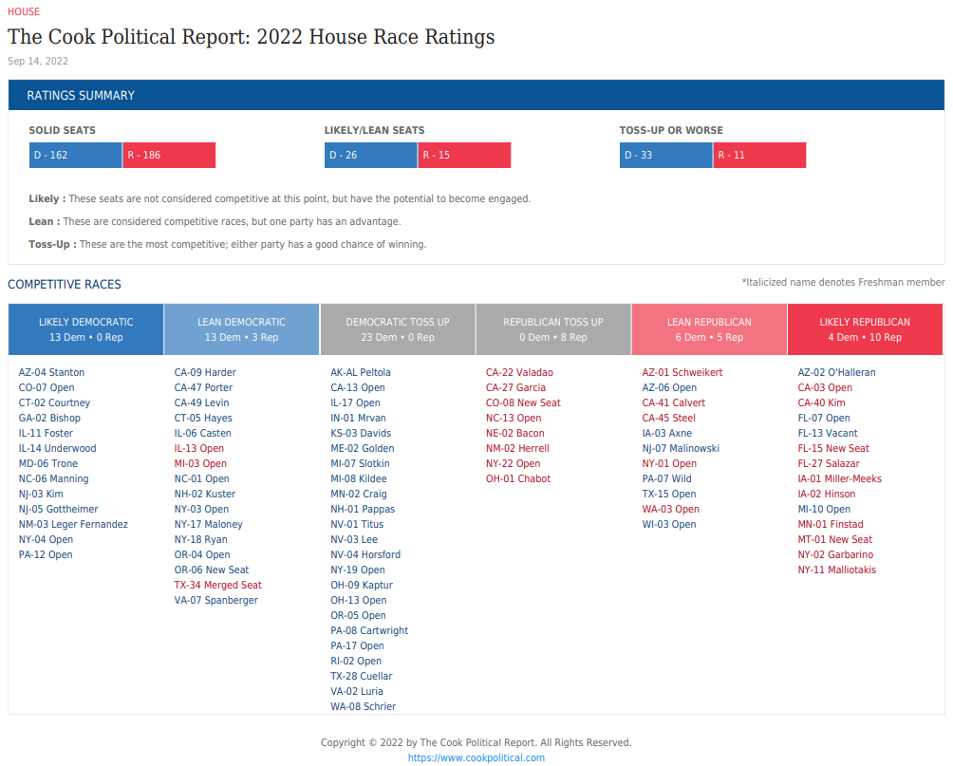
2022 Congressional Elections Pre-Election Analysis of U.S. House (Sept. 2022)
In March 2022, the Cook Political Report expected that there would be 20 “toss up” seats in the 2022 midterm elections, by September 2022, that number increased to 31 “toss ups”
Republicans have more opportunities to pick up seats since 15 more “toss ups” are currently-held or previously-held (now open seats) by Democrats
Notes:
2022 House Race ratings | Cook Political Report
https://www.cookpolitical.com/ratings/house-race-ratings

Slide 18
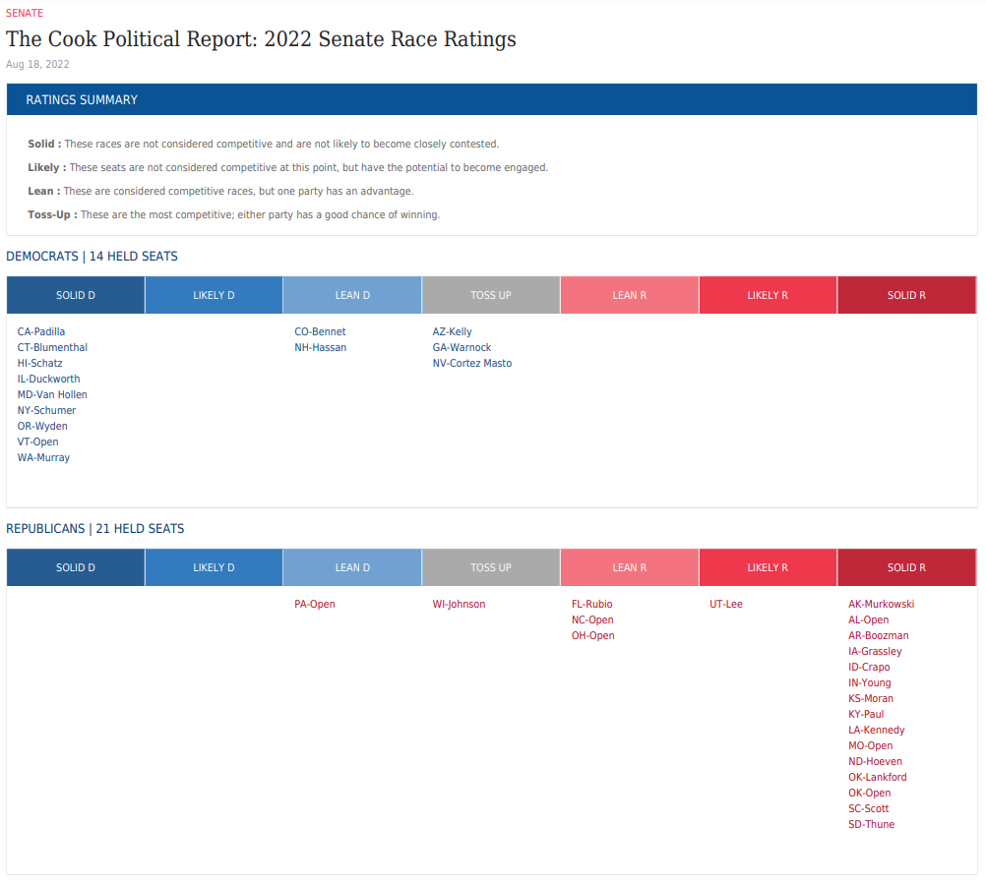
2022 Congressional Elections Pre-Election Analysis of the US Senate (Sept. 2022)
In Sept. 2022, the Cook Political Report expected four (4) U.S. Senate races to be “toss ups,” down from 5 expected “toss ups” in Mar. 2022
Going into the 2022 midterm elections, the US Senate is 50 – 50, so either party could win a majority in 2022
This seat will flip to the Democrats if this prediction holds on Election Day
Notes:
2022 Senate Race ratings | Cook Political Report
https://www.cookpolitical.com/ratings/senate-race-ratings

Slide 19
Balance of Power
Post-Election Results: 2022 Congressional Elections
Notes:
The Red Puddle Election of 2022 (dnyuz.com) https://dnyuz.com/2022/11/11/the-red-puddle-election-of-2022/ -- This is a 2022 post-election analysis and a history lesson on party dominance in America.
The 1980s Hangover and the GOP › American Greatness (amgreatness.com) https://amgreatness.com/2022/11/10/the-1980s-hangover-and-the-gop/ -- This is a Republican who is upset with Republican leadership for ignoring how important it is for Republicans to vote by mail
2022 midterms analysis: The Supreme Court’s abortion decision in Dobbs v. Jackson hurt Republicans – Vox https://www.vox.com/policy-and-politics/23451103/2022-midterms-results-data-analysis-abortion-dobbs-shor – David Shor is a Democratic political analyst and consultant, who gives his take as to why the Democrats did so well to stop the “red wave” in 2022. He thinks the abortion issue was the most important factor.
Red wave after all? GOP winning popular vote by wide margin despite incongruous results | Just The News https://justthenews.com/politics-policy/elections/red-wave-after-all-gop-winning-popular-vote-wide-margin-despite – Republicans have won the popular nationwide vote, yet it appears at the time of this writing to translate into a

Slide 20
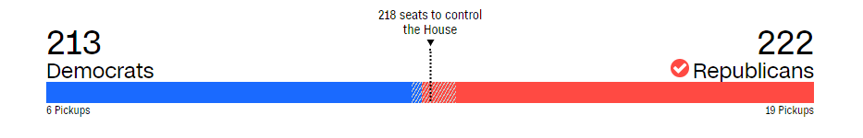
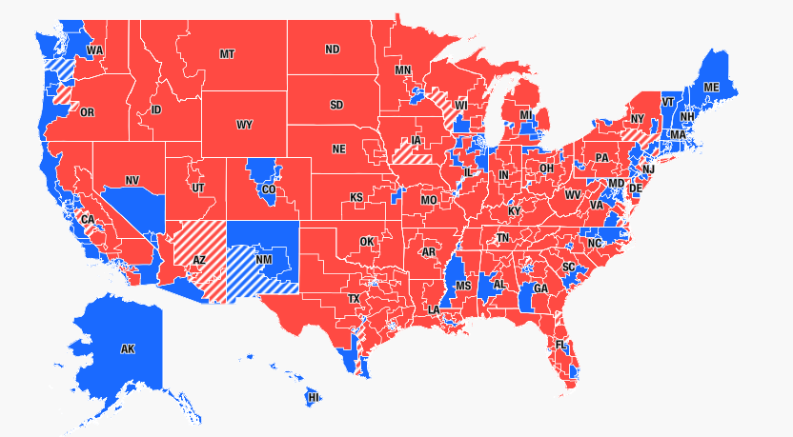
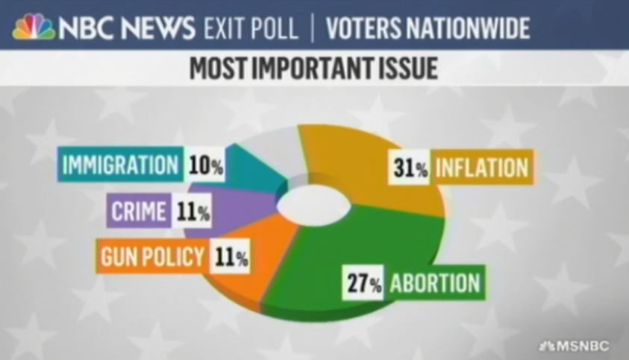
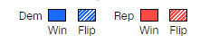
2022 Congressional Elections The House Results
Republicans netted 9 seats in 2022. It was a disappointing victory b/c Republicans expected a “wave” election, hoping to win 30 to 40 seats
The 435 U.S. House Districts
Abortion was the most important issue for 27% of voters and may have been responsible for blunting the “red wave”
Notes:
Source: https://www.cnn.com/election/2018/results/house

Slide 21
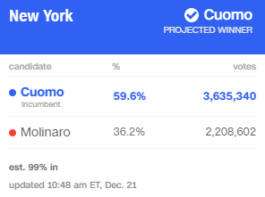
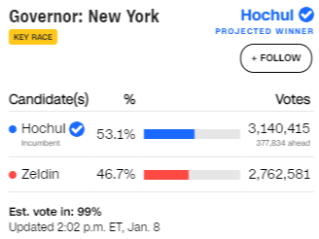
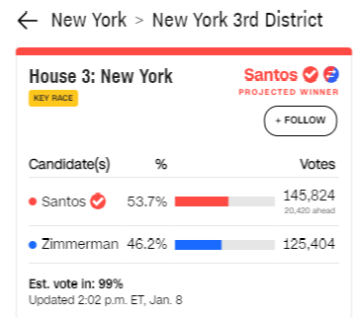
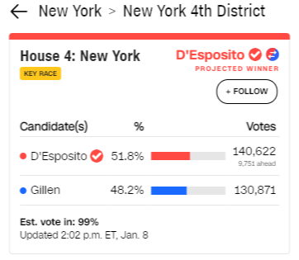
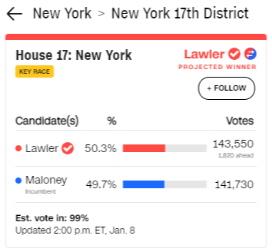
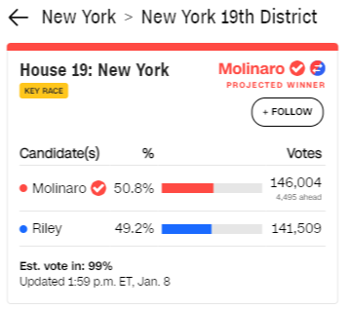
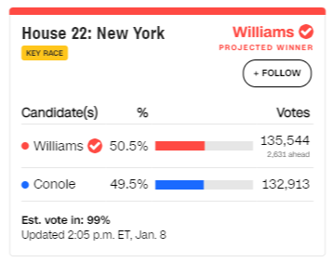
2022 Congressional Elections New York: The Key to Republicans Barely Winning the House in 2022
2018 Governor’s Race
2022 Governor’s Race
The NY governor’s race was much closer in 2022 (6.4% win for the Democrat) than in 2018 (23.4% win for the Democrat)
Lee Zeldin (R) ran on the issue of “crime” in NYC, and that resonated with NY voters
Zeldin’s anti-crime message helped House Republicans “flip” 4 U.S. House seats and hold one. Had Democrats won these 5 seats, then Democrats would have held on to a majority in the U.S. House in 2022
Republican “flipped” seats in NY in 2022
Republican “held” open seat in NY in 2022
Notes:
Source: https://www.cnn.com/election/2018/results/house
Republicans pick up 3 New York House seats with Long Island sweep and defeat of DCCC chair – POLITICO https://www.politico.com/news/2022/11/09/2022-midterm-new-york-house-elections-republican-00065919 – Crime was the top issue in NYC suburbs.

Slide 22
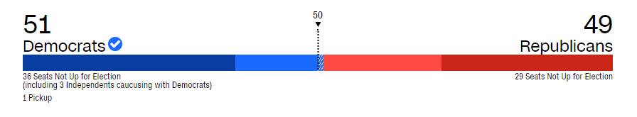
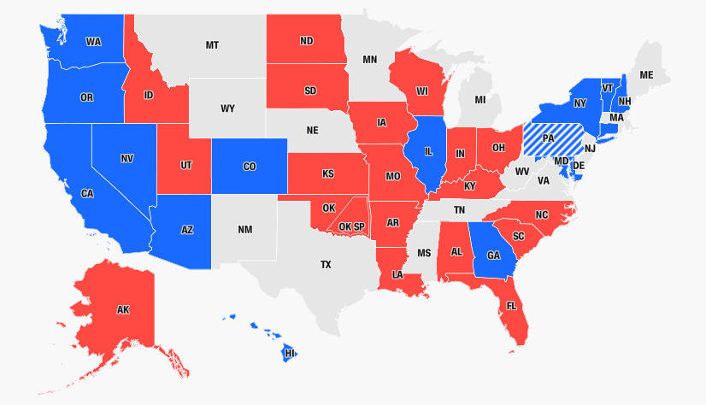
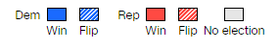
2022 Congressional Elections The Senate Results
U.S. Senate Seats up for Election in 2022
Democrats netted 1 seat in 2022, taking a 51 – 49 majority in the U.S. Senate
Republicans were hoping to win a majority in a “wave” election, but Trump-backed Republican candidates lost, e.g., Walker in Georgia and Dr. Oz in Pennsylvania
Notes:
Source: https://www.cnn.com/election/2018/results/senate

Slide 23
Congressional Elections
Incumbency Advantages & Disadvantages

Slide 24
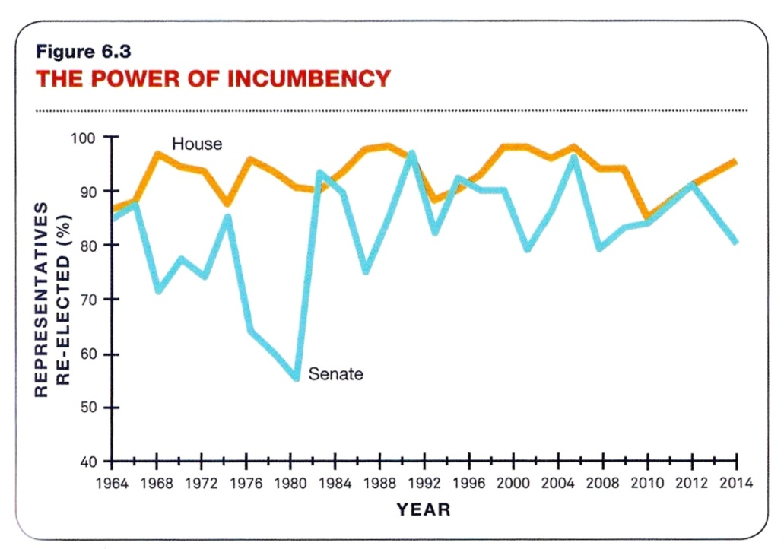
U.S. House/Senate Elections The Incumbency Advantage
Incumbency Advantage
Incumbents almost always win!!
95% incumbency reelection rate in the US House
Usually 80+% reelection rate in the US Senate
Incumbents have advantages in name recognition, in serving constituents back home, in fund-raising
Republicans won a majority in the Senate in 1980
Republicans won a majority in the Senate in 2014
Deception in the Numbers
Despite exceptionally high incumbency reelection rates, changes in majority control can and do occur: 1980, 1994, 2006, 2010, 2014, 2018 (not shown on graph)
Republicans won a majority in the House and Senate in 1994
Republicans won a majority in the House in 2010
Democrats won a majority in the House and Senate in 2006
Notes:
Source (of graphic): American Government, Power and Purpose, 13th ed.
Source: https://www.opensecrets.org/overview/reelect.php – to see up-to-date graphics of reelection rates for the House and Senate through 2016.
What is an incumbent?? The person who holds the elected office is an incumbent, the person running for reelection. An “open seat” is one where there is no incumbent running for reelection. For instance, in 2016, Harry Reid (D-NV) is not running for reelection, so the Nevada Senate seat will be competed by new candidates on both sides.
Incumbents have advantages over challengers:
No. 1: Constituency Services – Incumbents have become very good at addressing the needs of their constituents. This is especially true for the elderly who count on social security checks and other government aid
No. 2: Safe Seats – Many US House districts are drawn to give one party an overwhelming advantage. For instance, voting patterns in a given district may be 80% democratic, 20% Republican, ensuring that the US House seat would be won by a Democrat (or vice versa: 80% Republican, 20% Democrat). Officially, a safe seat is defined as one where one party wins by a margin of more than 10% of the popular vote, e.g., 55% to 45%.
Most of the 435 seats in the US House are “safe,” meaning that the same party will win that seat over and over again (see example on slide above). A competitive district is one that leans toward one party or one that is a toss up (the winning party wins by less than a 10% margin in the popular vote). There were only about 51 out of 435 seats in the US House that were truly competitive in 2006. In 2008, 58 seats were competitive. It was a Democratic year, and many more Republicans were vulnerable in 2008 than usual.
(See http://www.cookpolitical.com/charts/house/competitive_2008-11-04_13-32-49.php).
In 2010, 100 seats in the US House were competitive, and this time Democrats were more vulnerable – and it turned out to be a Republican year, with Republicans picking up 63 seats in the US House (http://www.cookpolitical.com/charts/house/competitive_2010-11-01_12-12-36.php).
In Jan 2014, The Cook Political Report estimated that there would be 45 competitive districts (15 tossups, 14 leaning Democratic, and 16 leaning Republican) in U.S. House elections, though Wikidpedia (see US House elections, 2014) reported that about 81 seats were competitive on Election Day 2014. Democrats would have had to have to netted about ~15 races to take a majority in the U.S. House, meaning Democrats would have had to have to won 30 of these 45 races. In the Nov. 2014 elections, Republicans increased their margins in the U.S. House, winning an additional 13 seats—it was a strong election for Republicans.
(See: http://en.wikipedia.org/wiki/United_States_House_of_Representatives_elections,_2014)
In Nov 2015, The Cook Political Report estimated that there will be about 32 competitive districts (14 tossups, 5 leaning Democratic, 13 leaning Republican).
In Aug. 2016, the Cook Political Report estimated that there would be about 37 competitive U.S. House districts (19 toss-ups, 7 leaning Democratic, and 11 leaning Republican). Of the 19 toss-ups, 16 incumbents are Republican and 3 or Democrats, so Democrats have a better shot of picking up seats than Republicans. Also, of the 7 seats that lean Democratic, 3 incumbents are Republican.
Other incumbency advantages: franking privileges (free use of US mail), name recognition, popularity in home district (mainly due to constituency services), and fund-raising (contributors are more willing to give money to those already in power)
1980 was a landslide victory for Reagan (a republican); still, incumbents won 55% of Senate elections.
Think about this: if there are 435 seats in the US House, and all incumbents run for reelection 90% of incumbents win, then 10% of the seats can change parties. 10% equates to 43 seats. If all of those seats are won by one party and consequently lost by the other party, then that would be a swing of 86 seats for the winning party, which could easily result in a change of power from one party to another, even when 90% of incumbents win reelection.
In 1994, 92% of incumbents won reelection. Still it was a landslide victory for Republicans. The 92% number is a little deceiving; it implies there cannot be a change in power from one party to the other. But in 1994, there was a swing of 52 seats, which was enough to change the majority control in the House from Democratic to Republican.
In 2006, 97% of incumbents won reelection. Still, it was a landslide victory for Democrats. There was a swing of 30 seats in the US House, which was enough for Democrats to take control.
2016 enthusiasm for voting: http://i2.cdn.turner.com/cnn/2015/images/12/22/cnnpoll.pdf

Slide 25
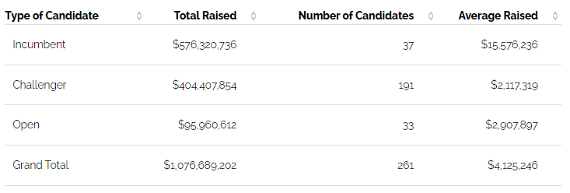
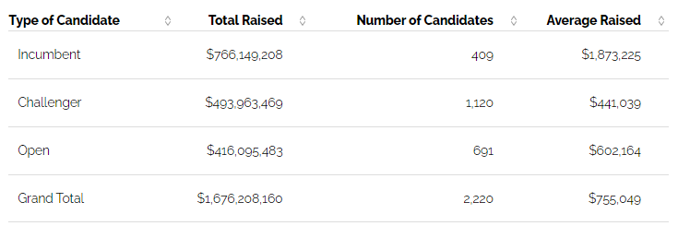
U.S. House/Senate Elections Incumbency Advantage: Fund-Raising (2018 Cycle)
The vast majority of campaign donations go to incumbents, who win reelection ~90% of the time
Special interest groups understand that incumbents are more likely to win, and they want to gain favor with the winner, so it is in their interest to donate more money to the favored candidate
U.S. Senate
In 2018, Senate incumbents raised almost 8 times the money that their challengers raised
House incumbents raised about 5 times the money their challengers raised
U.S. House
Notes:
Source: https://www.opensecrets.org/elections-overview/incumbent-advantage?cycle=2018
About Term Limits
Advocates of “term limits” want a constant influx of new faces in Congress, which they hope would reduce corruption, the theory being that politicians would come to Washington DC to do the nation’s business for a few years and then go back home to their former careers. Thus, there would no longer be career politicians. But the “term limits” movement (for elected officials at the national level) went away after the Republicans took control of majorities in both houses of Congress in the 1994 midterm elections. Prior to that, it was thought that Democrats would always be in the majority and that some external mechanism would be necessary if there was to be a change in power and an influx of new faces and fresh ideas. Twelve (12) years later, in 2006, the Democrats took back control of Congress. Then, 4 years after that, in 2010, Republicans took back the majority in the U.S. House. Then, the majority changed back to the Democrats in 2018. So, perhaps elections are working. If power changes hands often enough, then an external mechanism like term limits won’t be necessary.

Slide 26
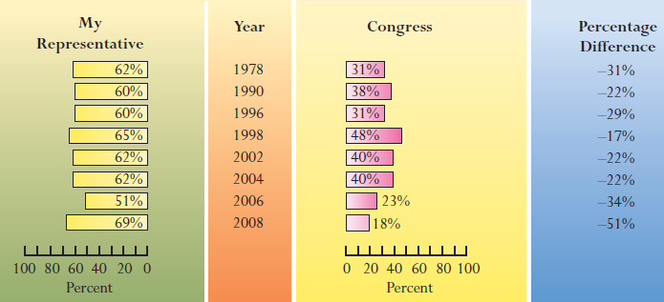
U.S. House/Senate Elections Incumbency Advantage: Public Opinion in the Home District or State
What is deceptive is the overall approval of Congress, which was a miserably low 18% in 2008. but the overall approval rating of Congress does not predict a big change in the composition of Congress. Individual approval numbers in the home district is a more influential predictor
In 2008, on average, the approval rating of a US House member in his or her home district was 69% approval, which is very high and almost assures that the incumbent would be reelected
Notes:
The favorable perception of one’s own member to the US House has a lot to do with constituency services and “pork” or “earmarks” that the congressperson brings home to the district. This is one reason why members don’t want to get rid of “pork barrel” projects; they believe it helps them win reelection over and over again.
Take 2008 as an example. On average, a member of the U.S. House had a favorability rating of 69% in his or her home district, which is very good. This indicates that the constituents in the home district like their member of Congress, but the favorability of Congress as a whole was only 18%, which is terrible. Still, what drives the incumbency advantage is the popularity of individual member of Congress in their home districts, not what the public thinks about Congress as a whole.
In a 13 Oct. 2013 Pew Research Poll, only 23% had favorable views of Congress as a whole, while 74% had unfavorable views.

Slide 27
US House/Senate Elections
Are incumbents ever vulnerable? Yes.
Incumbents are vulnerable to scandal, presidential coattails, and redistricting (see notes below slide for details)
The House Bank Scandal (1991) – 77 of 110 incumbents did not return to Washington following the 1992 election, either because they retired or were defeated in the primary or general election.
Sex Scandals – Between 2000 and 2022, ~15 US House and Senate members and one (1) governor were forced to resign for engaging in sex scandals. All but one were men (just one woman), most were married, a few were gay
Sexual harassment – became an issue in 2017, resulting in resignations of 1 US Senator and 5 members of the US House, as well as elected leaders in state legislatures across the states (including 2 members in the Texas House)
Presidential Coattails – If a presidential candidate wins in a landslide, and the House or Senate incumbent is of a different party, the incumbent may be vulnerable to losing because more voters vote “straight ticket”
“Safe seats” will likely limit the effect of coattails the next time there is a landslide in a presidential election
Redistricting (Gerrymandering) – States draw district lines for the US House; sometimes districts are drawn to defeat incumbents of the party different from the one in power in the state legislature
Notes:
Source (sexual harassment/assault in 2017): https://en.wikipedia.org/wiki/2017_United_States_political_sexual_scandals#Allegations_against_members_of_the_United_States_House_of_Representatives
House Bank Scandal (1991): The House bank would allow its members to write “hot” checks (w/o penalty), with the understanding the money would be paid back. Those who wrote “hot” checks were essentially receiving a free loan from the House bank. Average people don’t get to write “hot” checks without being punished, and our leaders are not supposed to receive special treatment. This is why the scandal was so controversial—our leaders were receiving special treatment.
In the 1992 congressional elections, following the House Bank scandal which occurred the previous year (1991), 52 House members and 7 senators retired. That was more retirements than in any other election year. Many feared being run out because of their involvement in the House Bank scandal, so instead of facing defeat, they retired instead. These retirements may have allowed democrats to maintain control of the US House and Senate because new Democratic faces were presented to the public. Some who were caught up in the House Bank scandal did run again and a good many of them, 18 of 24, were defeated by a member of their own party in the primary elections. A total of 77 House incumbents out of the 110 who had written hot checks did not return to Washington, either because they retired or because they were defeated in the primary or general election.
There were other factors causing anti-incumbent sentiment in 1992 besides the House Bank scandal. Gridlock between a Democratic-controlled Congress and a Republican president frustrated the public. Nothing was being done about the budget deficit; Republicans and Democrats just couldn’t agree. Perot’s candidacy for president in 1992 focused on gridlock and its resulting consequence: budget deficits year after year with no end in sight. Perot won an amazing 19% of the popular vote in the 1992 election.
Corruption Scandals: There were a few corruption scandals that involved Republicans in 2005-2006. Duke Cunningham (R-CA) was sent to jail for illegally accepting bribes from defense contractors. Bob Ney (R-OH) was also sent to jail for changing his vote on casino gambling after receiving a campaign contribution from casino owners who needed his vote on legislation affecting their businesses (this was a bribe). Tom DeLay (R-TX) resigned after being indicted for money laundering. DeLay had contacts with Jack Abramoff, who was a Washington DC lobbyist who has been indicted for defrauding Indian tribes. Some believe these scandals came back to haunt Republicans in the 2006 midterm elections, when Democrats took back control of Congress.
In 2010, Democrats could have been negatively effected by scandals (though the 2010 midterm elections were really about a backlash to “bigger government”). One high profile case involved Charles Rangel (D-NY), who stepped down from his position as Chairman of the Ways and Means Committee in the US House, while there was an ongoing ethics investigation about him. Rangel accepted free travel to the Bahamas from business groups and he failed to report income from properties he owns overseas and in NYC on his tax returns. The irony is that Rangel was chairman of the committee that handles all taxation matters in the US House. In the end, the U.S. House did not expel Rangel; rather, they “censured” him (a censure is a formal rebuke, essentially telling a member that they had done wrong).
Sex scandals: In 2019, Katie Hill, a Democratic member of the House from California, resigned because of a sex scandal. Allegedly, she was having an affair with Graham Kelly, her legislative director, but Hill denied the affair. Red State published a picture that implied that Ms. Hill might have been having an affair with a female staffer (the picture showed Katie Hill naked, sitting in a chair, combing the hair of a fully-clothed staffer: https://www.washingtonexaminer.com/news/photograph-shows-naked-democratic-congresswoman-brushing-hair-of-female-campaign-worker). The Daily Mail also published the same photograph and many more that show Hill and her female lover (see: Shocking photos of Democratic Congresswoman Katie Hill revealed | Daily Mail Online https://www.dailymail.co.uk/news/article-7609835/Katie-Hill-seen-showing-Nazi-era-tattoo-smoking-BONG-NAKED.html) (Hill’s husband was okay with Katie being with another woman, but when Katie started an affair with a male staffer, her husband filed for divorce). Katie Hill is the only woman to have resigned because of a sex scandal.
In 2011, Anthony Weiner (D-NY) was exposed for sending a picture in his underwear with an erection as well as sexually explicit texts to a woman that was not his wife. Weiner first claimed that the picture was a prank and that his email (or some other form of social media, I’m not sure which) was hacked. Andrew Breitbart of BigGovernment.com had the “goods” on Weiner (because other women had contacted Breitbart), so Weiner eventually admitted to sending the picture. The scandal continued to intensify because Weiner refused to resign, but after the Democratic leadership in Congress failed to back him and public pressure mounted, Weiner resigned his seat in the US House. Earlier in 2011, Christopher Lee (R-NY) was exposed for soliciting a date from a woman who had posted an ad on Craig’s List. Lee lied about his marital status (he was married but lied about that), profession (he was a congressman but lied and said he was a lobbyist), and age (he was 46 but lied and said he was 39). The woman he had solicited for a date figured out that Lee was a Congressman and then exposed him to the media. Lee promptly resigned his position in Congress. In 2010, Eric Massa (D-NY) was accused of sexually harassing male staffers. Massa refused to answer questions about his sexuality, daring those to ask his wife, his former Navy sailors, or anyone else who knew him about that part of his life. The media then investigated his career in the Navy and learned that Massa routinely used his authority to sexually harass or make moves on men below him in the Navy hierarchy. Massa resigned his position in Congress before any more information came out about him. The Republicans demanded an investigation into what Speaker of the House Nancy Pelosi knew about Massa’s behavior. They believed she should be held to the same standard as Dennis Hastert (Speaker from 1998 – 2007), who was held responsible for the Mark Foley (gay) sex scandal. But the Republicans won majorities in the 2010 elections, and Pelosi was out as Speaker, so the scandal went away.
In 2009, Sen. John Ensign (R-NV) admitted to having an affair with a campaign staffer. Ensign was married and so was the staffer with whom he had an affair. Ensign was considered a rising star in the Republican Party and was considering a run for the presidency in 2012. Ensign was also outspoken in his criticism of Bill Clinton’s adulterous affair with Monica Lewinsky in the late 1990s, which made him look very hypocritical when his adultery was exposed. Also in 2009, Gov. Mark Sanford (R-SC) of South Carolina admitted to having an adulterous affair; he too was viewed as a possible up-and-comer in the Republican Party, which will no longer be the case.
In 2007, Senator Larry Craig (R-ID) was caught soliciting sex from an undercover officer in a Minneapolis airport bathroom, which is allegedly a meeting place for gay men to engage in anonymous sex. Sen. Craig denied the allegations of the solicitation and did not to resign his US Senate seat (though he did not run for reelection in 2008, so he is no longer a US Senator), much to the chagrin of many of his Republican colleagues who wanted him gone.
In 2006, Mark Foley (R-FL) resigned because it was revealed that he had had sexually explicit instant message exchanges with teenage pages. Pages are high-school kids who are temporarily hired as interns to serve on the staffs of members of Congress so that they can be introduced to how politics actually works. Some political analysts believe the sex scandal adversely affected Republicans all over the country because of the allegation that the Republican leadership in the US House didn’t do enough to stop Foley when they were first informed of his inappropriate behavior.
In 2002, 50+ year old Gary Condit (D-CA) had a relationship with 24-year old Chandra Levy, one of his interns. Chandra Levy was mysteriously killed in Rock Creek Park (Washington DC), and for a time, Condit was a suspect. He is no longer a suspect, however. In 2009, Levy’s murderer was identified. He had been in jail for another crime but apparently the authorities have linked him to the murder. In 2016, an inmate who fingered Chandra Levy’s killer changed his story, so the person who was suspected of killing Levy is no longer a suspect.
Also, in 2002, Tim Hutchinson (R-AK) lost in the Republican primaries because of an affair he was having with a younger woman who worked for him.
https://en.wikipedia.org/wiki/List_of_federal_political_sex_scandals_in_the_United_States – Here is a more comprehensive list of sex scandals in Congress. There are at least 3 on this list that I have not given details about in the paragraphs above: Mark Souder (R-IN), Scott DesJarlais (R-TN), David Wu (D-OR), and Vance McAllister (R-LA)
Presidential Coattails – When a presidential candidate wins in a landslide (defined as a victory of greater than 10% in the popular vote across the country), many voters vote “straight ticket,” i.e., if the presidential candidate is a Republican, then they vote for the Republican for Senate and for the US House and for state offices. So, given this example, Republicans at lower offices tend to receive more votes because the voter likes the presidential candidate of the same political party, and many of these Republicans at the lower offices win, bringing in a lot of new members of the same political party as the winning presidential candidate. There are so many safe seats in the US House today, that some political experts predict that the coattail effect will be diminished the next time there is a presidential landslide. But who knows. Obama won by 7% in 2008, which was not officially a landslide but still a comfortable win. Obama brought in 21 new Democrats to the US House and 8 new Democrats to the US Senate. That was a descent coattail effect.
Redistricting: States redraw US House districts after every national census (every 10 years). When state legislatures redraw US House districts, the legislators know the voting patterns within each geographically-enclosed district. So, they can draw district boundaries with majority Republican voting patterns which will almost always ensure a Republican gets elected from that district. Districts can also be drawn to almost always guarantee a Democratic winner. In Texas, Republicans took over both the Texas House and Senate for the first time since the Reconstruction Era (1870s) in 2003. The US House districts were drawn to give Republicans a 21-to-11 advantage in the Texas delegation to the US House. Five (5) Democratic incumbents lost in the 2004 elections. In 2006, the US Supreme Court upheld the 2003 Texas redistricting but forced the Texas Legislature to redraw 1 of 32 congressional districts because that district had been drawn to diminish the power of Hispanics
In 2022, New York hopes to flip 4 currently-held Republican seats to Democrats, similar to what Texas did in 2004, flipping 5 previously-held Democratic seats to Republicans. See: New York’s Gerrymander Might Change Which Party Picks Up Seats In The Midterms | FiveThirtyEight
https://fivethirtyeight.com/videos/new-yorks-gerrymander-might-change-which-party-picks-up-seats-in-the-midterms/

Slide 28
Recent Elections
2020 Congressional Election Results Coinciding with 2020 Presidential Election

Slide 29
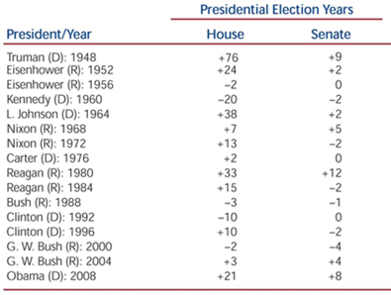
2020 Congressional Elections Post-Election: The Influence of a Popular Presidential Candidate
Some presidential winners have “coattails,” meaning they also help members of their own party win congressional elections, namely, Reagan in 1980 and Obama in 2008
Post-Election (2020)
Joe Biden was elected president in 2020, but he did not have coattails in the US House, with Democrats losing a net of 13 seats, though Democrats still maintained a majority, and since Democrats gained seats in the Senate, Biden had small coattails in that chamber On Election Night (2020), it appeared that the Republicans would hold the majority of seats in the Senate, but Trump’s claim that the election was stolen suppressed the vote in the Georgia special elections two months later, on Jan. 5th 2021, and Democrats picked up both Georgia Senate seats, producing a 50-50 US Senate (VP Kamala Harris would break the tie)
President/Year Obama (D): 2012 | House +8 D | Senate +2 D
President/Year Trump (R): 2016 | House -5 R | Senate -2 R
President/Year Biden (D): 2020 | House -13 D | Senate +3 (D)
Notes:
Explanation of the graph: A “+” indicates that the presidential candidate’s party picked up a seat in the U.S. House or Senate.

Slide 30
2018 Midterm Elections
2018 Congressional Election Results

Slide 31
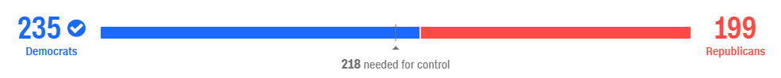
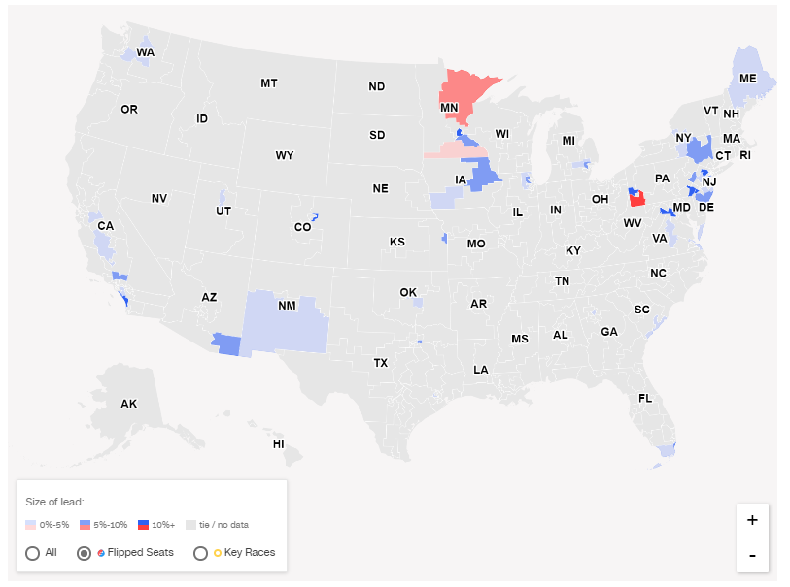
2018 Congressional Elections The House Results
House Seats that Flipped from one Party to the other Party
Democrats netted 40 House seats in 2018, taking a majority in the House for the first time since the 2007-2011 timeframe
It was a “wave” election for Democrats
Notes:
Source: https://www.cnn.com/election/2018/results/house

Slide 32
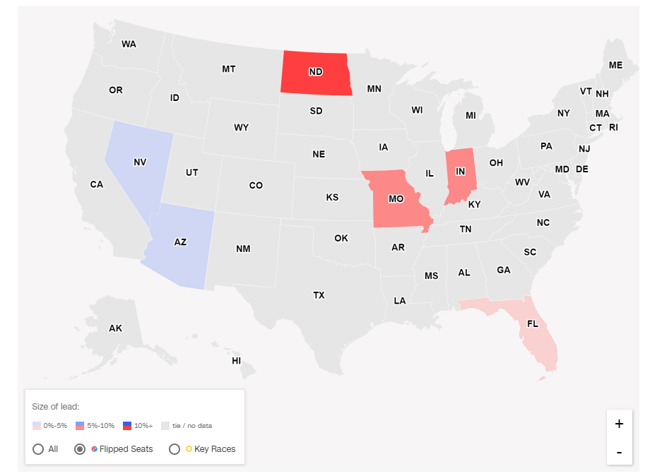
2018 Congressional Elections The Senate Results
Senate Seats that Flipped from one Party to the other Party
Republicans netted 2 senate seats in 2018, increasing their majority from 51 senators (out of 100) to 53 senators
Democrats were hoping the “wave” would extend to the Senate, but Republicans were able to hold on to a majority
Notes:
Source: https://www.cnn.com/election/2018/results/senate

Slide 33
2018 Midterm Elections
Pre-Election Analysis of 2018 Congressional Elections

Slide 34
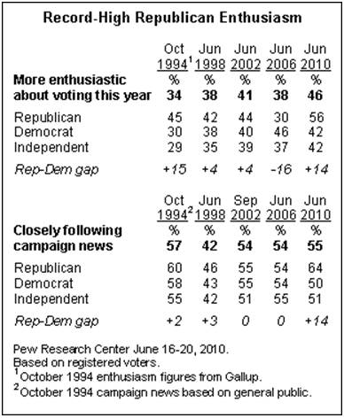
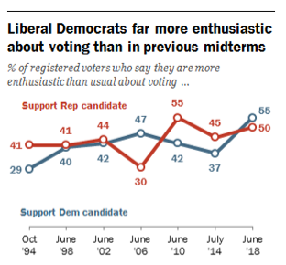
2018 Congressional Elections Pre-Election Analysis: The Influence of “Enthusiasm to Vote”
1994, 2010 and 2014 were “wave” elections for Republicans in Congress. 2006 was a “wave” election for Democrats in Congress. “Enthusiasm to vote” was a good predictor of these “waves,” in most cases, 5 months in advance of the election.
Note the “enthusiasm gap” in 1994, 2006, and 2010
The “enthusiasm gap” favored Democrats in 2018 by 5%, which is a smaller gap than the gaps that existed in previous wave elections. However, “liberal” Democrats were far more enthusiastic to vote than “conservative” Republicans, 64% to 53%, respectively, an 11% gap (not shown on graphic presented, see notes below slide for link to the graphic)
In 2006, the last time the Democrats won a “wave” midterm election, “liberal” Democrats were 23% more enthusiastic to vote than “conservative” Republicans.
President – Year | U.S. House Seats Won | U.S. Senate Seats Won
Clinton (D) – 1994 | R +52 | R +10
Bush (R) – 2006 | D +30 | D +6
Obama (D) – 2010 | R +63 | R +6
Obama (D) – 2014 | R +13 | R +9
Trump (R ) -- 2018 | D +40 | R +2
Note: There was a change in the majority in each of these elections except in the U.S. Senate in 2010 and 2018
Notes:
Source (Jun 2018 graphic): “Voters More Focused on Control of Congress – and the President – than in Past Midterm Elections,” June 20, 2018. http://www.people-press.org/2018/06/20/voters-more-focused-on-control-of-congress-and-the-president-than-in-past-midterms/. The Report breaks out enthusiasm for “liberal” Democrats and “conservative” Republicans, and finds that liberals are 11% more enthusiastic to vote than their conservative counterparts in the other party.
http://i2.cdn.turner.com/cnn/2015/images/12/22/cnnpoll.pdf – In Dec. 2015, a CNN/ORC International Poll of 1000 Americans found that 59% of Republicans and 46% of Democrats were either “extremely enthusiastic” or “very enthusiastic” to vote in the 2016 presidential race. The difference favored Republicans by 13%, but I must note this poll did not ask the respondents if they were enthusiastic to vote in the 2016 congressional elections, which the other surveys presented on the slide did.
Pew Research Center (June 2010): http://people-press.org/report/630/ -- In June 2010, 44% of independent voters planned to vote Republican in the 2010 midterm elections and 36% of independent voters planned to vote Democratic, giving Republicans an 8% edge among independent voters
------------------------------------------------------------------------
Republicans won a historic election in 2010, picking up 63 seats in the U.S. House, winning the majority. Republicans did not win a majority in the Senate in 2010. There were 4 Senate races that were highly personalized (meaning these races were not decided by national forces sweeping across the country but rather by the evaluations of the candidates in the races), and Democrats were able to hold on to a majority in the U.S. Senate. However, in 2014, the outcome of Senate races was even better than the anticipated “best case scenario” for Republicans. Republican picked up 9 seats in the U.S. Senate, winning a majority in the Senate as well as increasing their majorities in the U.S. House

Slide 35
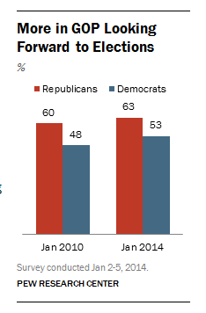
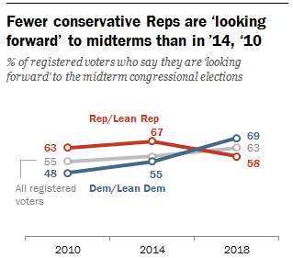
2018 Congressional Elections Pre-Election Analysis: The Influence of “Looking Forward” (in Anticipation)
2010 and 2014 were “wave” elections for Republicans in Congress. “Looking Forward” in anticipation of the Midterm Election was a good predictor of these “waves,” 10 months in advance of the election. In 2018, the advantage favored Democrats by 11%, which was comparable to the Republicans’
12-15% and 10-12% advantages in 2010 and 2014, respectively
Note the gaps in “anticipation” of the election in 2010, 2014, and 2018
President – Year | U.S. House Seats Won | U.S. Senate Seats Won
Obama (D) – 2010 | R +63 | R +6
Obama (D) – 2014 | R +13 | R +9
Trump (R ) -- 2018 | D +40 | R +2
Note: There was a change in the majority in each of these elections except in the U.S. Senate in 2010 and 2018
Notes:
Source (Jan. 2018 graphic): “Public Sees Better Year Ahead; Democrats Sharpen Focus on Midterm Elections,” Jan. 18, 2018. http://www.people-press.org/2018/01/18/public-sees-better-year-ahead-democrats-sharpen-focus-on-midterm-elections/ -- This poll asks are you “looking forward” to the midterm elections, rather than are you “more enthusiastic about voting than usual.” Still, “looking forward” in anticipation of the election is a pretty good measure in predicting “wave” midterm elections. In Jan. 2018, higher %’s of Democrats were looking forward to the Midterm Elections than Republicans, 69% compared to 58%, an 11% gap, very similar to the12-15% and 10-12% advantages Republicans enjoyed in 2010 and 2014, respectively, when they won big in the House and Senate elections.
Pew Research Center (June 2010): http://people-press.org/report/630/ -- In June 2010, 44% of independent voters planned to vote Republican in the 2010 midterm elections and 36% of independent voters planned to vote Democratic, giving Republicans an 8% edge among independent voters
Pew Research Center report: “In New Year, Half Are Looking Forward to Midterm Elections: More Republicans than Democrats Are Anticipating Midterms,” Jan. 7, 2014
See: http://www.people-press.org/2014/01/07/in-new-year-half-are-looking-forward-to-midterm-elections/
------------------------------------------------------------------------
Republicans won a historic election in 2010, picking up 63 seats in the U.S. House, winning the majority. Republicans did not win a majority in the Senate in 2010. There were 4 Senate races that were highly personalized (meaning these races were not decided by national forces sweeping across the country but rather by the evaluations of the candidates in the races), and Democrats were able to hold on to a majority in the U.S. Senate. However, in 2014, the outcome of Senate races was even better than the anticipated “best case scenario” for Republicans. Republican picked up 9 seats in the U.S. Senate, winning a majority in the Senate as well as increasing their majorities in the U.S. House

Slide 36
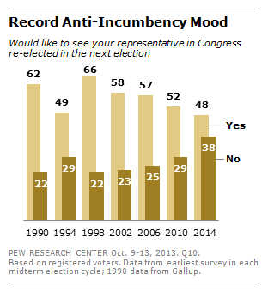

2018 Congressional Elections Pre-Election Analysis: The Influence of Anti-Incumbent Sentiment
The anti-incumbent sentiment in 2010 looks very similar to that in 2018, with about the same %’s for those who would like to see their representative reelected, 49% in 2010 to 48% in 2018, as well as for members of the “out-party,” 42% for Republicans in 2010 and 43% for Democrats in 2018
In 2018, the anti-incumbent sentiment was 33%, i.e., 33% did not want their rep in Congress to be reelected. This is a higher % than the 29% sentiment felt in the 2010 “wave” election, though slightly lower than the 38% felt in 2014
When anti-incumbent sentiment is high, this sometimes predicts a “wave” election, as was the case in 1994, 2010, 2014, and 2018 (not so much in 2006 though, which was also a “wave” election). It is important to note that these were “midterm” elections
Notes:
Source: “Public Sees Better Year Ahead; Democrats Sharpen Focus on Midterm Elections,” Jan. 18, 2018. http://www.people-press.org/2018/01/18/public-sees-better-year-ahead-democrats-sharpen-focus-on-midterm-elections/
Source: “Record Anti-Incumbent Sentiment Ahead of 2014 Elections: More than a Year Out, Democrats Hold Slim Lead over Republicans,” Oct. 15 2013 – This poll was taken before the conclusion of the government shutdown in October 2013, so the anti-incumbent sentiment may be a little higher in this poll because the shutdown was unpopular with the public.
See: http://www.people-press.org/2013/10/15/record-anti-incumbent-sentiment-ahead-of-2014-elections/
2010: Anti-Incumbent Sentiment
A Pew Research Center Poll (Feb. 2010) found the anti-incumbent sentiment heading into the 2010 midterm elections was as high as it was in 1994 and 2006, elections years in which the balance of power changed in Congress. Here is a quote from the Pew Research Center (http://pewresearch.org/pubs/1489/survey-midterm-elections-challenges-for-both-parties-wallstreet-abysmal-ratings): “The wild card in voter opinion at this point is the level of anti-incumbent sentiment, which is as extensive as it has been in 16 years of Pew Research Center surveys. About three-in-ten voters (31%) say they do not want to see their own representative reelected, which is well above the average percentage expressing this view in 29 previous surveys (23%). The only recent midterm campaigns when anti-incumbent sentiment equaled its current levels were in 2006 and 1994 -- which culminated in elections that changed the balance of power on Capitol Hill.”
A June 2010 Pew Research Poll showed anti-incumbent sentiment at 34%, 3% higher than in Feb. 2010. See: http://people-press.org/report/630/
Anti-Incumbent Sentiment = Retirements
Typically, when anti-incumbent sentiment is so high, many Representatives and Senators retire, rather than risking defeat in the next election. In 2010, 37 members of the US House and 12 members of the US Senate retired: 20 Republicans in the US House v. 17 Democrats – and – 6 Republicans in the US Senate v. 6 Democrats (source: Wikipedia – US House Elections, 2010 & US Senate Elections, 2010). 49 members of Congress retired rather than risk a defeat in the 2010 midterm elections. 59 members retired in 1991 following the House bank scandal. There was no major scandal in 2010, just strong anti-incumbent sentiment (probably because of the runaway spending and record deficits that Congress had authorized).
In 2014, 41 members of the U.S. House and 6 members of the US Senate retired (25 Republicans (10 ran for the US Senate, 6 won, 4 lost) and 16 Democrats (2 ran for the US Senate, 1 won, 1 lost) in the House –and– 4 Democrats and 2 Republicans in the Senate (Republicans won 5 of 6 of these seats)). The number of retirees were comparable to 2010, when 49 retired (47 retired in 2014).
In 2016, 43 members of the U.S. House and 5 members of the U.S. Senate retired. That number (48 in total) is comparable to 2010 (49 retirees) and 2014 (47 retirees). Of course, 2016 was not a midterm election. Still, the high number of retirees indicated high anti-incumbent sentiment among the voters. Though, on Election Day, Trump had no “coattails,” still Republicans held their majorities in the US House and US Senate, which was considered a victory for Republicans.
In 2018, as of Jan. 31st from one source (either Wikipedia or Vox.com, don’t remember which) 55 members of Congress are retiring, 38 Republicans and 17 Democrats. This number is higher than 2010 and 2014, indicating that the anti-incumbent mood in the country is very high in 2018. If the past is any indicator of what may happen in 2018, Democrats (the out-party, not holding the presidency) should win big.
In 2022 -- https://ballotpedia.org/List_of_U.S._Congress_incumbents_who_are_not_running_for_re-election_in_2022 – 55 members of the Congress are not running for reelection in 2022, 49 in the US House and 6 in the US Senate
https://www.npr.org/2021/12/09/1061182786/house-retirement-tracker-2022-congress-republicans-democrats – 31 Democrat and 18 Republican incumbents are not running again in 2022
The anti-incumbent sentiment is high in 2022, which should indicate a potentially big win for Republicans (the out-party, not holding the presidency)

Slide 37

2018 Congressional Elections Pre-Election Analysis: Anti-Trump Sentiment among Democrats
Presidents are typically non-factors in midterm elections, particularly when campaigning for members of their own party
But if presidents are polarizing, like Trump, that can motivate turnout against the president in midterm elections
Republicans were strongly motivated to vote against Obama in the 2010 and 2014 midterm elections, and those were “wave” elections for Republicans
The motivation among Democrats to vote against Trump in the 2018 midterm elections (61%) was almost as strong as it was to vote against Bush in 2006 (65%), which turned out to be a “wave” election for Democrats…but the motivation among Republicans to vote for Trump’s interests (52%) could have offset the Democratic advantage
Notes:
Source (Jun 2018 graphic): “Voters More Focused on Control of Congress – and the President – than in Past Midterm Elections,” June 20, 2018. http://www.people-press.org/2018/06/20/voters-more-focused-on-control-of-congress-and-the-president-than-in-past-midterms/. The motivation among Democrats to vote against Trump’s interests in the 2018 Midterm has increased from 56% (in Feb. 2018) to 61% (in June 2018). Though, the motivation among Republicans to vote for Trump’s interests in the 2018 midterm elections is unusually strong, at 52%. Still, there is a 9% advantage for Democrats more motivated to vote against Trump’s interest over the % representing Republicans who are motivated to vote for Trump’s interests.
Source: “Public Sees Better Year Ahead; Democrats Sharpen Focus on Midterm Elections,” Jan. 18, 2018. http://www.people-press.org/2018/01/18/public-sees-better-year-ahead-democrats-sharpen-focus-on-midterm-elections/ -- This shows the president, current and past, and the motivation each inspires to vote for or against the President’s party in the midterm elections. Trump’s numbers wree terrible in Jan. 2018 but they improved via George Bush, whose motivated an even greater % of Democrats to want to vote against Bush’s party in the 2006 Midterm Elections.

